Slide 2

FORMATION TRACKING CONTROL FOR MULTI-ROBOT SYSTEMS BASED ON REINFORCEMENT LEARNING - ADP APPROACH
Instructor: Vũ Thị Thúy Nga
Student: Võ Khôi Thành Sơn | – 20202768

Slide 3
Table of contents
Introduction
System modeling
Multi-agent control design using traditional method
Multi-agent control design using adaptive dynamic programming approach
Simulation results
Conclusion

Slide 4
Introduction

Slide 5
1. Introduction
In this research, a system of multiple wheeled mobile robots is required to track and maintain specific formations while following desired trajectories.
The objectives of this work are:
Introduce the multi-agent consensus control algorithms for single- and double-integrator models, and ensure formation tracking of wheeled mobile robot system in case of no disturbance by traditional control method.
Present an ADP-based adaptive optimal controller for the wheeled mobile robot formation tracking, considering wheel slip and external disturbances.

Slide 6
System modeling

Slide 7
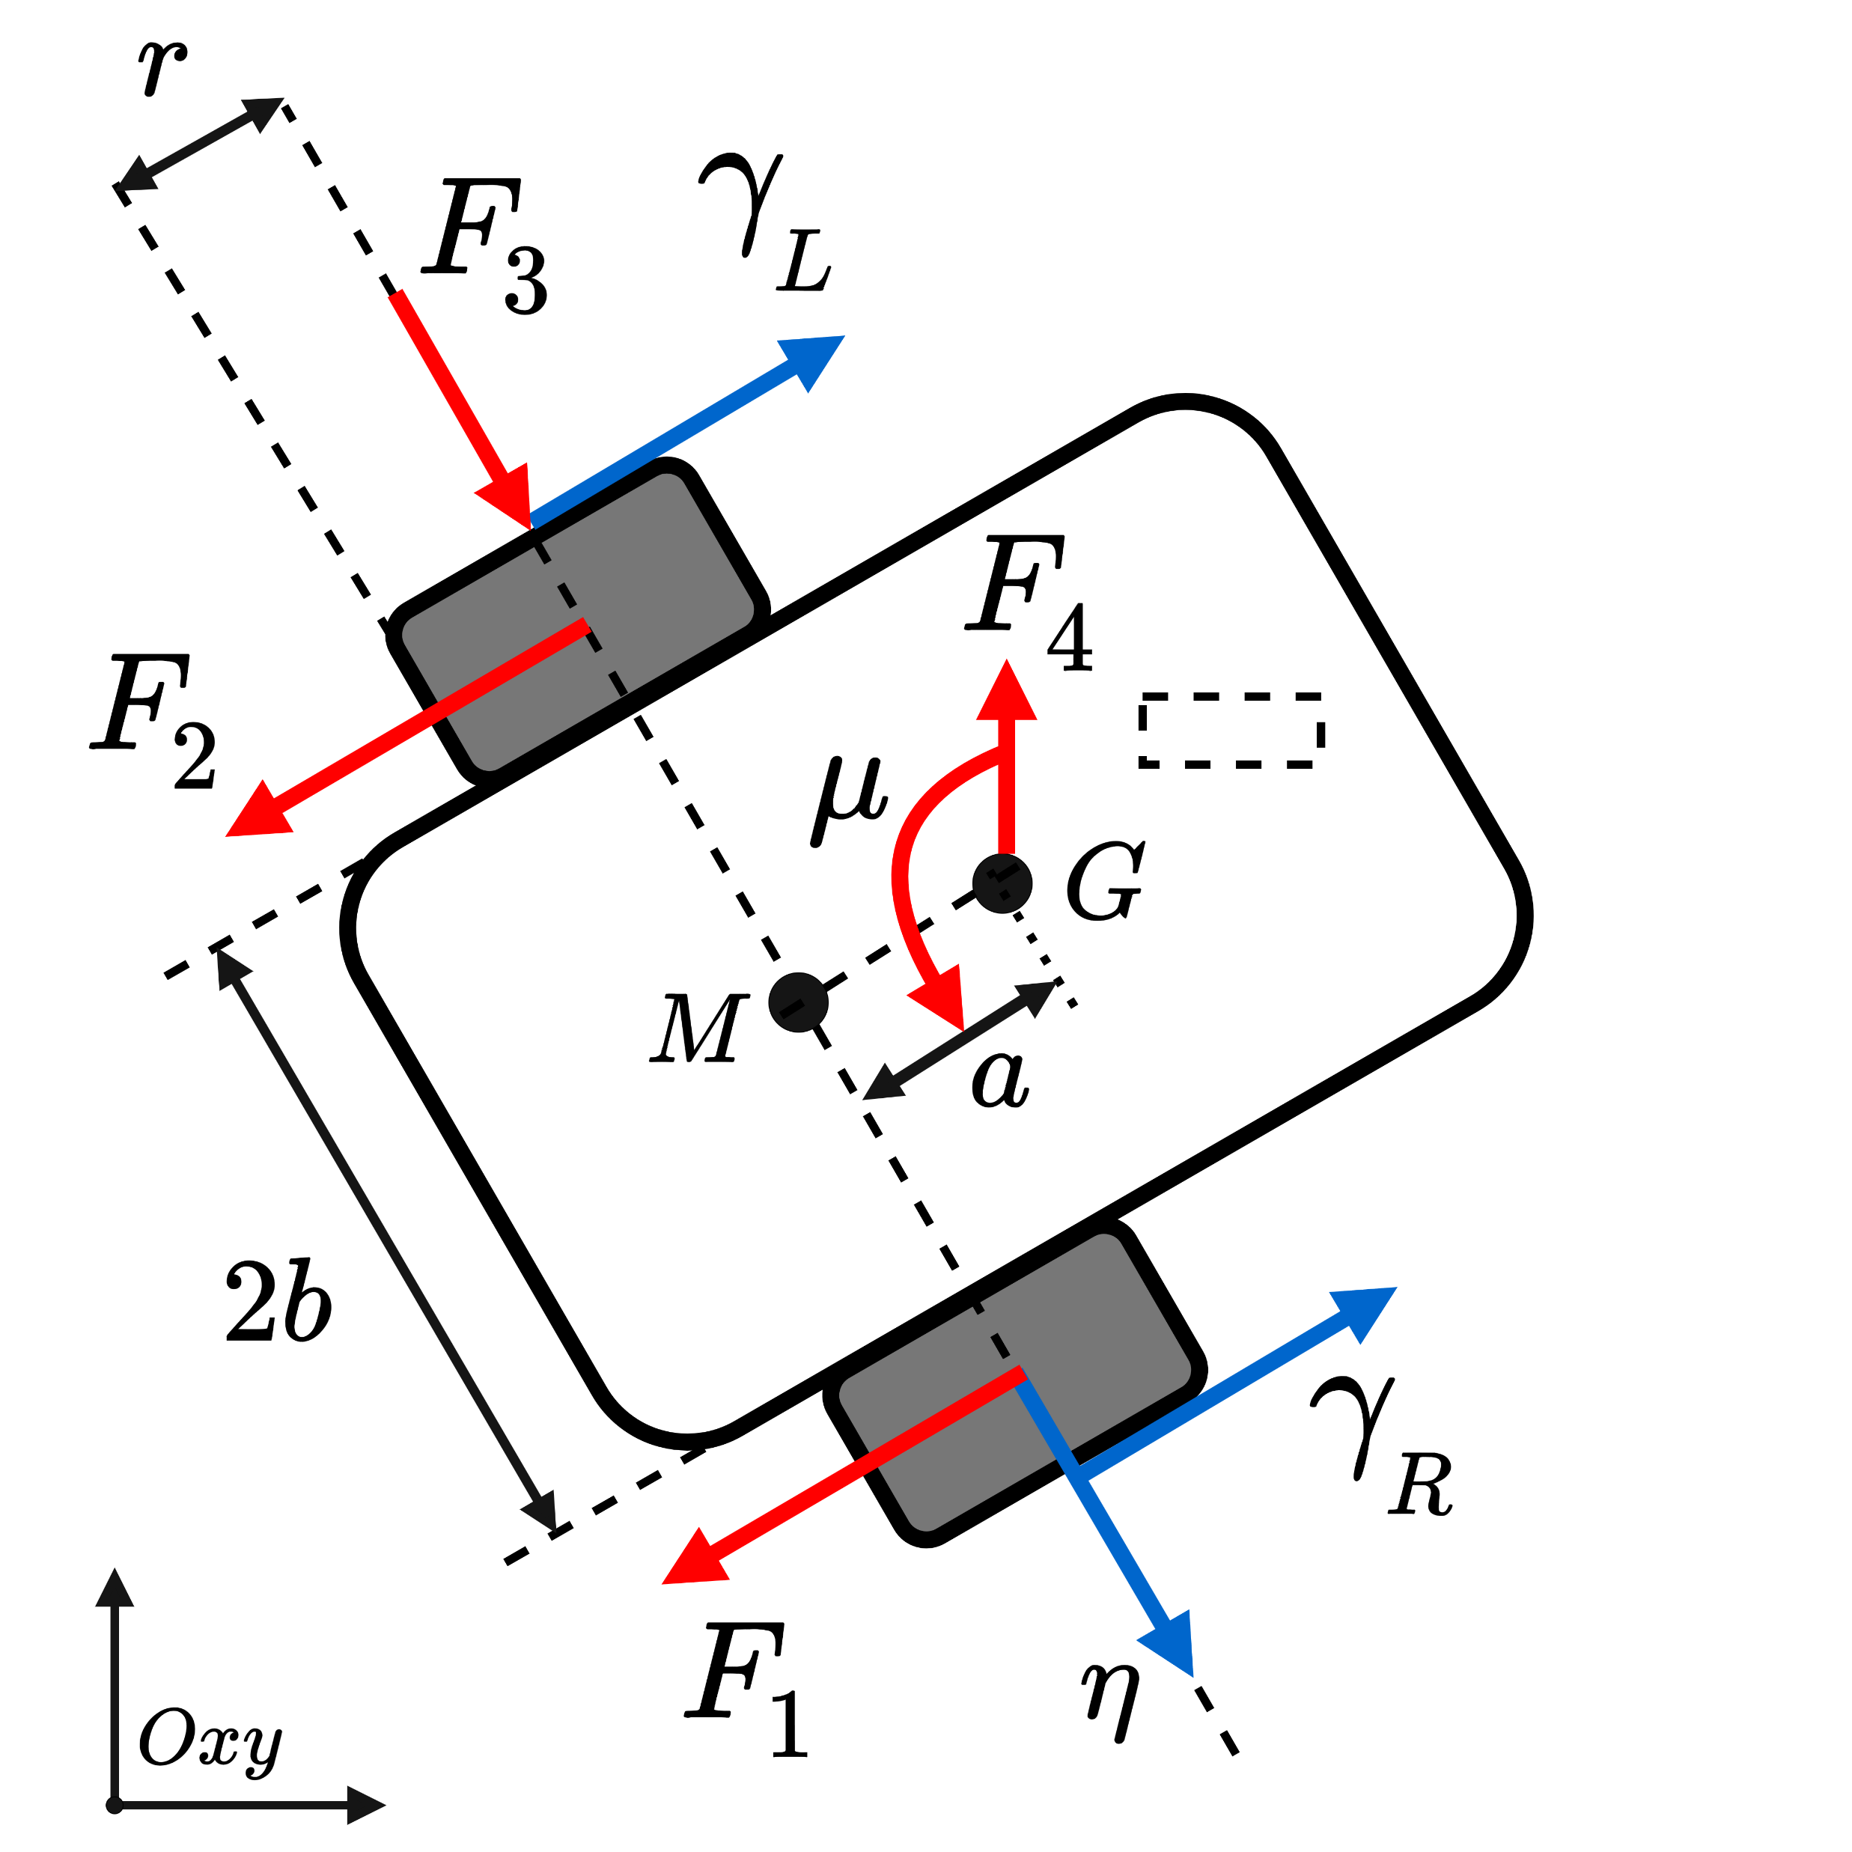
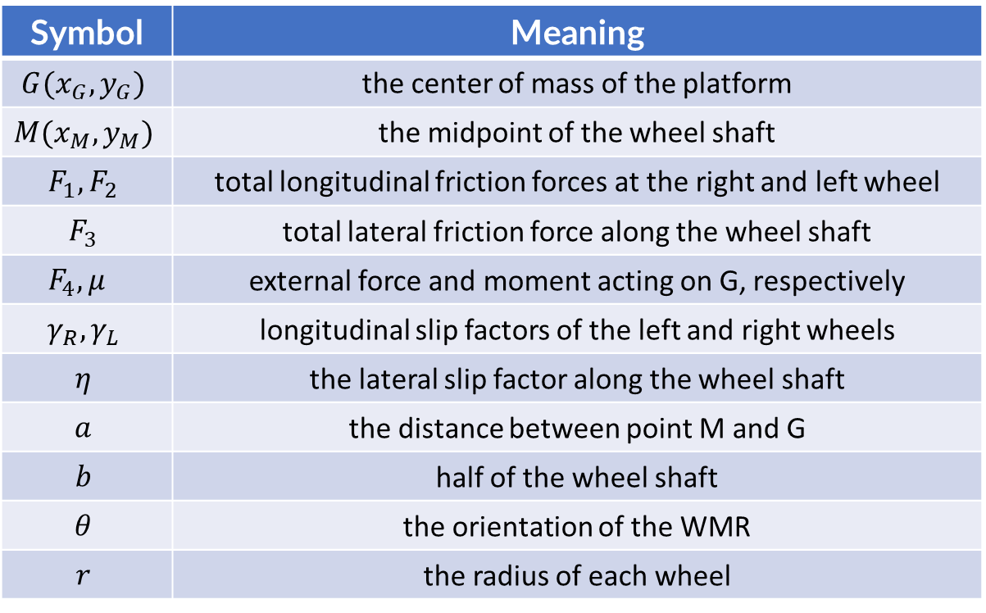
2. System modeling
A. Introduction of wheeled mobile robot (WMR)
Two main driving wheels, one free wheel
Symbol | Meaning
$$G(x_{G},y_{G})$$ | the center of mass of the platform
$$M(x_{M},y_{M})$$ | the midpoint of the wheel shaft
$$F_{1},F_{2}$$ | total longitudinal friction forces at the right and left wheel
$$F_{3}$$ | total lateral friction force along the wheel shaft
$$F_{4}, μ$$ | external force and moment acting on G, respectively
$$γ_{R}, γ_{L}$$ | longitudinal slip factors of the left and right wheels
$$η$$ | the lateral slip factor along the wheel shaft
$$a$$ | the distance between point M and G
$$b$$ | half of the wheel shaft
$$θ$$ | the orientation of the WMR
$$r$$ | the radius of each wheel
Diagram of the WMR

Slide 8
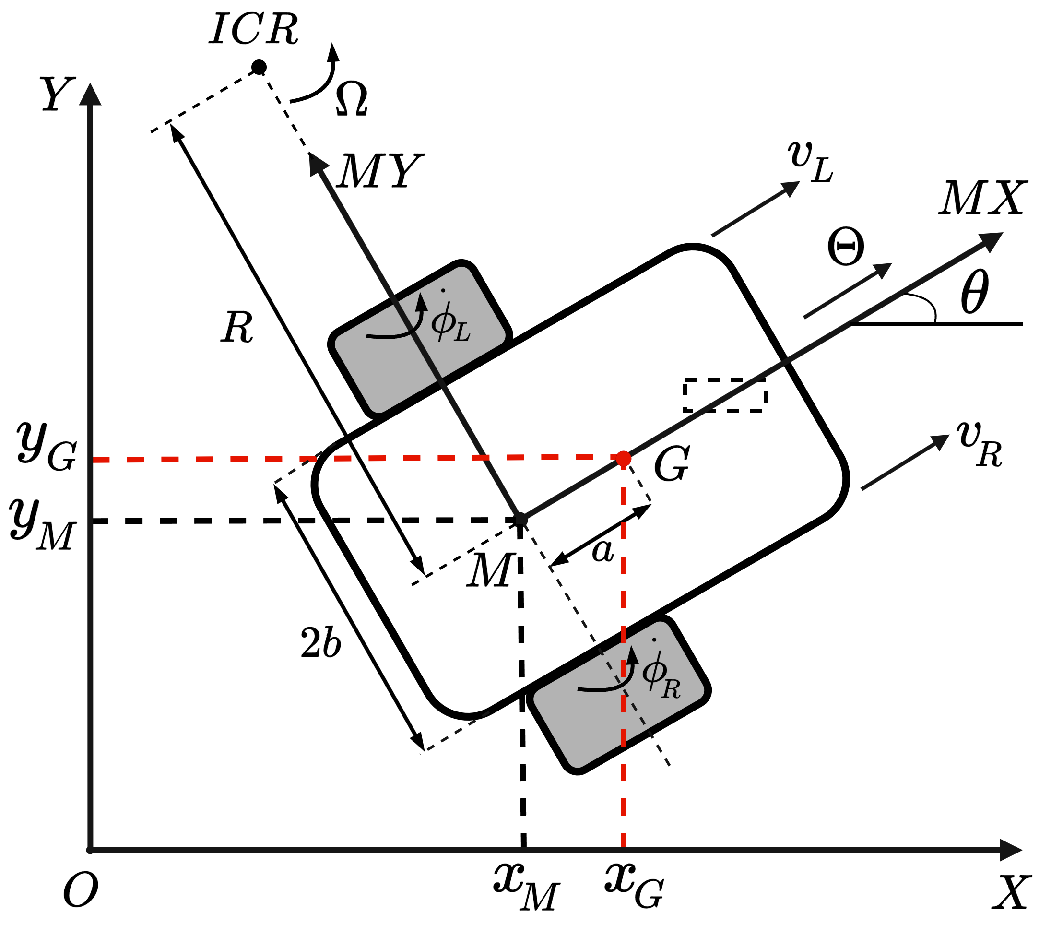
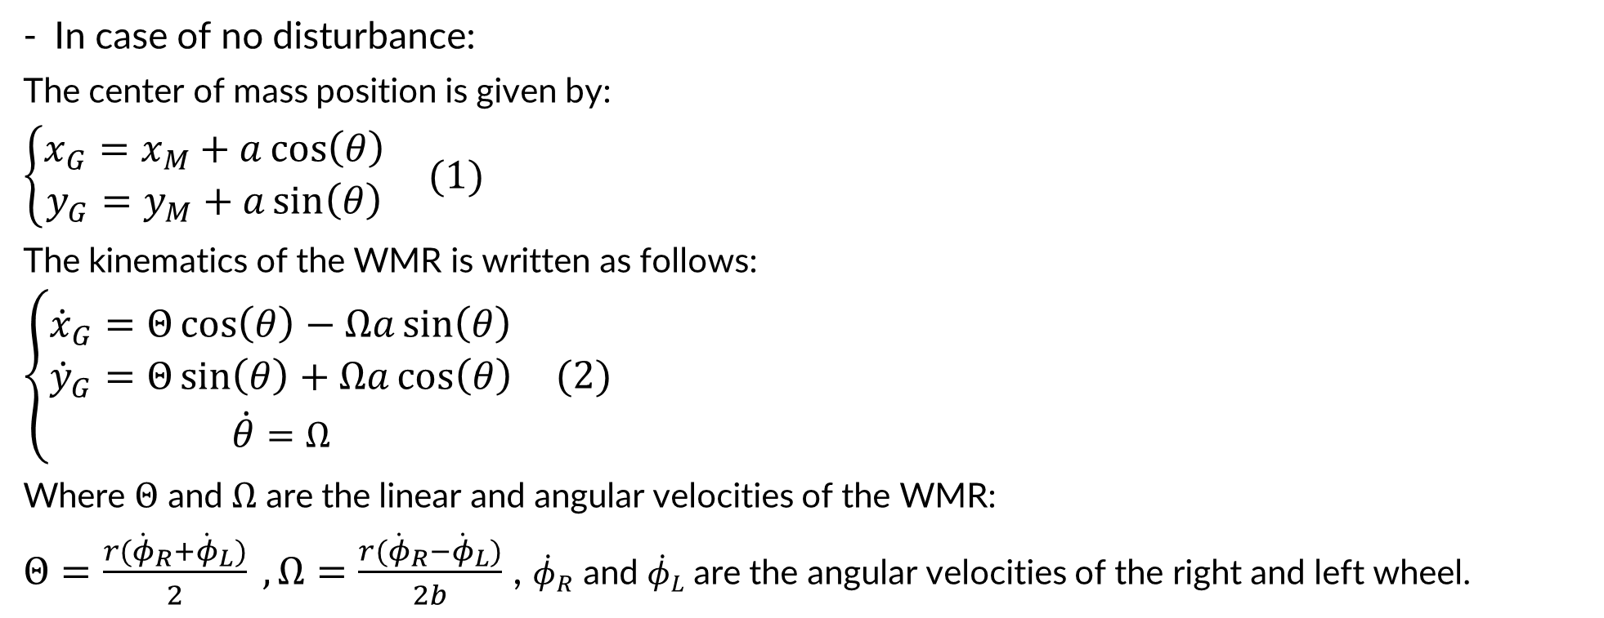
2. System modeling
B. WMR system model:
1. Kinematic model
In case of no disturbance:
The center of mass position is given by:
$\left\{\begin{aligned}x_{G}=x_{M}+a\cos\left(θ\right) \\ y_{G}=y_{M}+a\sin\left(θ\right)\end{aligned}\right. (1)$
The kinematics of the WMR is written as follows:
$\left\{\begin{aligned}{\dot{x}}_{G}=Θ\cos\left(θ\right)−Ωa\sin\left(θ\right) \\ {\dot{y}}_{G}=Θ\sin\left(θ\right)+Ωa\cos\left(θ\right) \\ \dot{θ}=Ω\end{aligned}\right. (2)$
Where $Θ$ and $Ω$ are the linear and angular velocities of the WMR:
$Θ=\frac{r({\dot{φ}}_{R}+{\dot{φ}}_{L})}{2} , Ω=\frac{r({\dot{φ}}_{R}−{\dot{φ}}_{L})}{2b}$ , ${\dot{φ}}_{R}$ and ${\dot{φ}}_{L}$are the angular velocities of the right and left wheel.
WMR coordinates

Slide 9
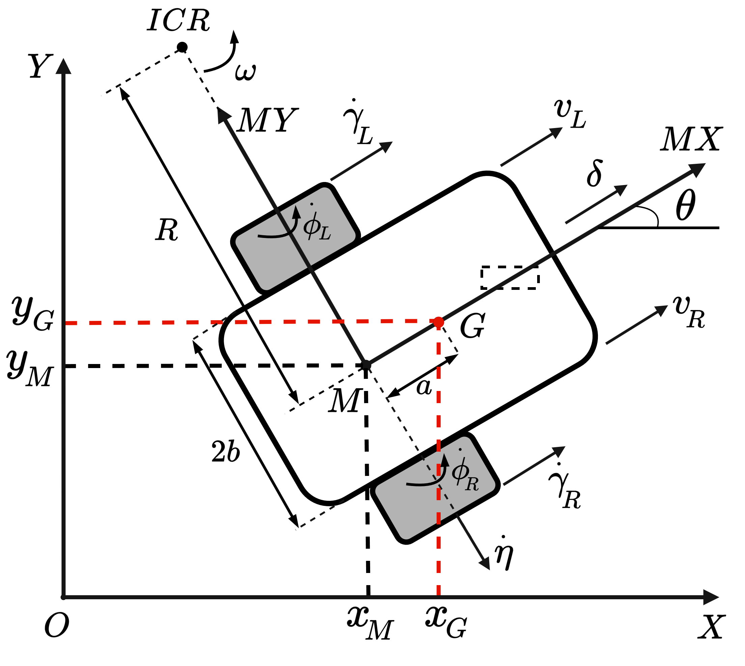
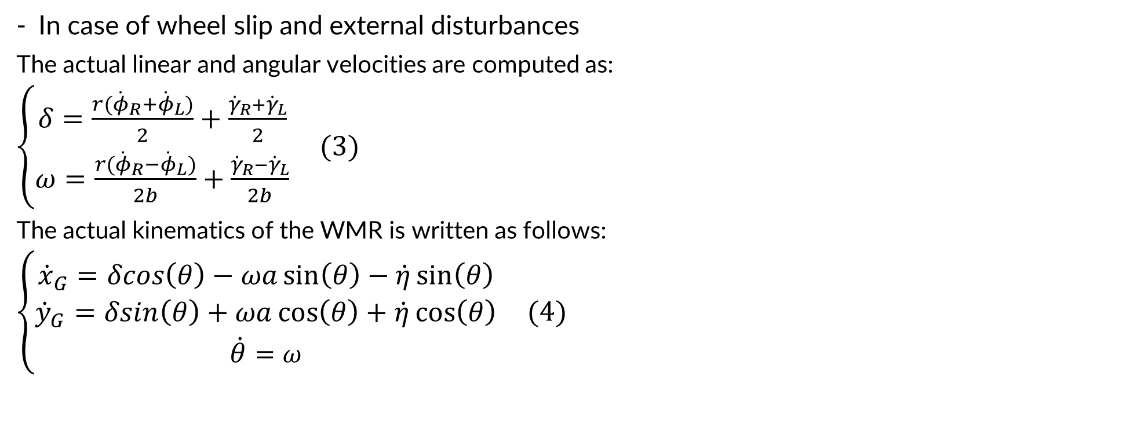
2. System modeling
B. WMR system model:
1. Kinematic model
In case of wheel slip and external disturbances
The actual linear and angular velocities are computed as:
$\left\{\begin{aligned}δ=\frac{r({\dot{φ}}_{R}+{\dot{φ}}_{L})}{2}+\frac{{\dot{γ}}_{R}+{\dot{γ}}_{L}}{2} \\ ω=\frac{r({\dot{φ}}_{R}−{\dot{φ}}_{L})}{2b}+\frac{{\dot{γ}}_{R}−{\dot{γ}}_{L}}{2b}\end{aligned}\right. (3)$
The actual kinematics of the WMR is written as follows:
$\left\{\begin{aligned}{\dot{x}}_{G}=δcos\left(θ\right)−ωa\sin\left(θ\right)−\dot{η}\sin\left(θ\right) \\ {\dot{y}}_{G}=δsin\left(θ\right)+ωa\cos\left(θ\right)+\dot{η}\cos\left(θ\right) \\ \dot{θ}=ω\end{aligned}\right. (4)$
WMR coordinates

Slide 10
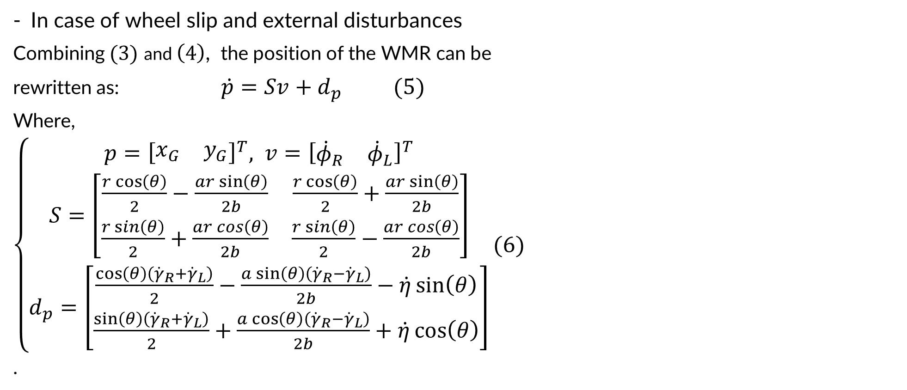
2. System modeling
B. WMR system model:
1. Kinematic model
In case of wheel slip and external disturbances
Combining $(3)$ and $\left(4\right)$, the position of the WMR can be
rewritten as: $\dot{p}=Sv+d_{p} (5)$
Where,
$\left\{\begin{aligned}p={\left[\begin{matrix}x_{G} & y_{G}\end{matrix}\right]}^{T}, v={\left[\begin{matrix}{\dot{φ}}_{R} & {\dot{φ}}_{L}\end{matrix}\right]}^{T} \\ S=\left[\begin{matrix}\frac{r\cos\left(θ\right)}{2}−\frac{ar\sin\left(θ\right)}{2b} & \frac{r\cos\left(θ\right)}{2}+\frac{ar\sin\left(θ\right)}{2b} \\ \frac{r\sin\left(θ\right)}{2}+\frac{ar\cos\left(θ\right)}{2b} & \frac{r\sin\left(θ\right)}{2}−\frac{ar\cos\left(θ\right)}{2b}\end{matrix}\right] \\ d_{p}=\left[\begin{matrix}\frac{\cos\left(θ\right)\left({\dot{γ}}_{R}+{\dot{γ}}_{L}\right)}{2}−\frac{a\sin\left(θ\right)\left({\dot{γ}}_{R}−{\dot{γ}}_{L}\right)}{2b}−\dot{η}\sin\left(θ\right) \\ \frac{\sin\left(θ\right)\left({\dot{γ}}_{R}+{\dot{γ}}_{L}\right)}{2}+\frac{a\cos\left(θ\right)\left({\dot{γ}}_{R}−{\dot{γ}}_{L}\right)}{2b}+\dot{η}\cos\left(θ\right)\end{matrix}\right]\end{aligned}\right.(6)$
.
WMR coordinates

Slide 11
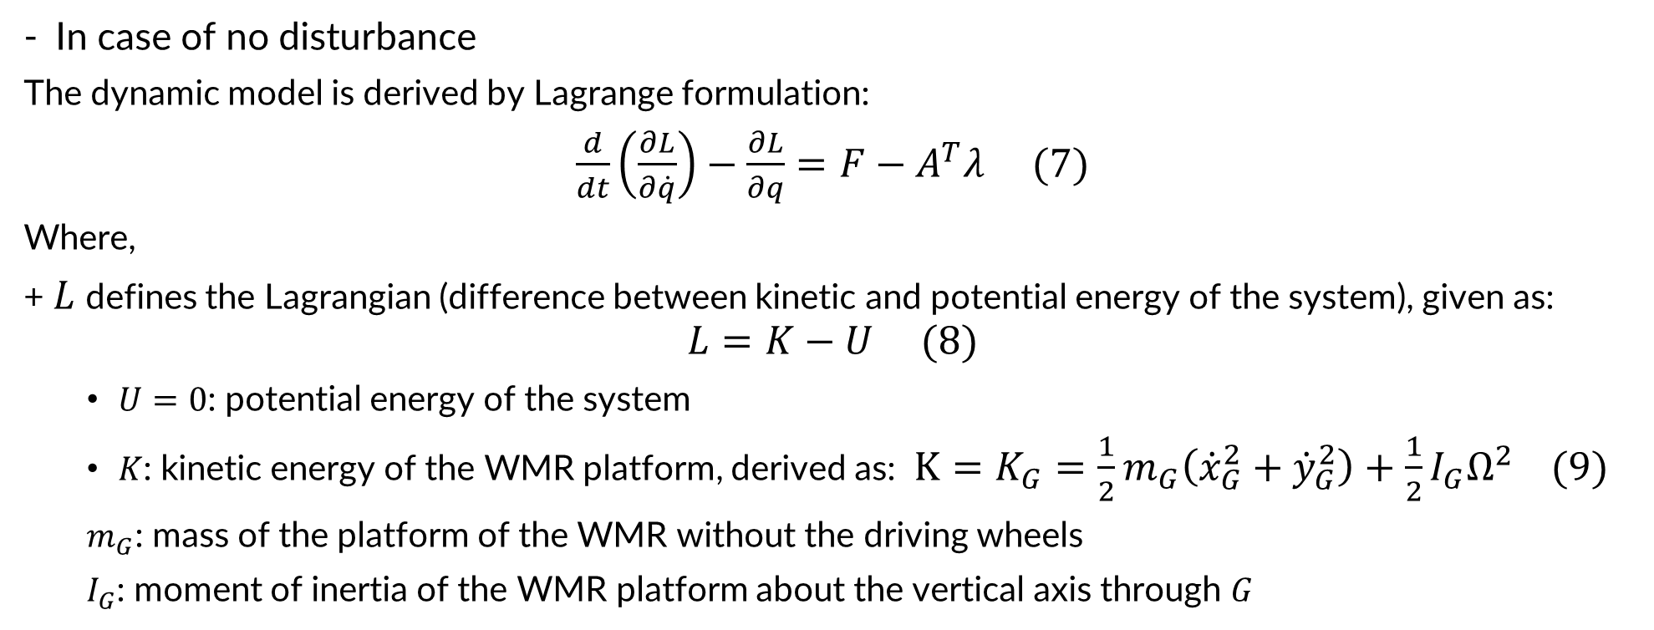
2. System modeling
B. WMR system model:
2. Dynamic model
In case of no disturbance
The dynamic model is derived by Lagrange formulation:
$\frac{d}{dt}\left(\frac{∂L}{∂\dot{q}}\right)−\frac{∂L}{∂q}=F−A^{T}λ (7)$
Where,
+ $L$ defines the Lagrangian (difference between kinetic and potential energy of the system), given as:
$$L=K−U (8)$$
$U=0$: potential energy of the system
$K$: kinetic energy of the WMR platform, derived as: $K=K_{G}=\frac{1}{2}m_{G}\left({\dot{x}}_{G}^{2}+{\dot{y}}_{G}^{2}\right)+\frac{1}{2}I_{G}Ω^{2} (9)$
$m_{G}$: mass of the platform of the WMR without the driving wheels
$I_{G}$: moment of inertia of the WMR platform about the vertical axis through $G$

Slide 12
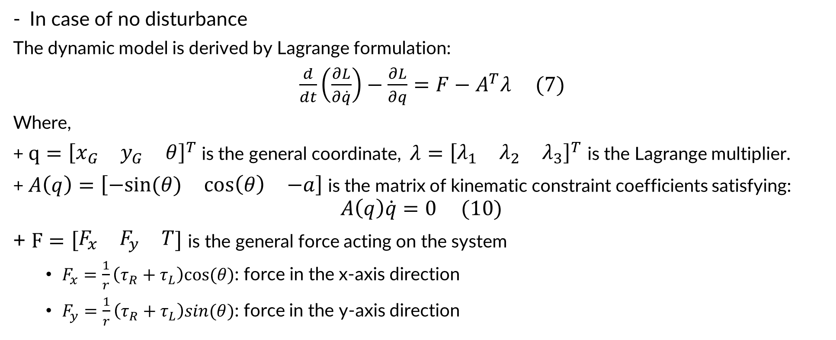
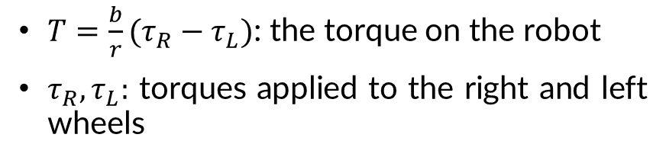
2. System modeling
B. WMR system model:
2. Dynamic model
In case of no disturbance
The dynamic model is derived by Lagrange formulation:
$\frac{d}{dt}\left(\frac{∂L}{∂\dot{q}}\right)−\frac{∂L}{∂q}=F−A^{T}λ (7)$
Where,
+ $q={\left[\begin{matrix}x_{G} & y_{G} & θ\end{matrix}\right]}^{T}$is the general coordinate, $λ={\left[\begin{matrix}λ_{1} & λ_{2} & λ_{3}\end{matrix}\right]}^{T}$ is the Lagrange multiplier.
+ $A\left(q\right)=\left[\begin{matrix}−sin⁡(θ) & \cos\left(θ\right) & −a\end{matrix}\right]$ is the matrix of kinematic constraint coefficients satisfying:
$$A\left(q\right)\dot{q}=0 (10)$$
+ $F=\left[\begin{matrix}F_{x} & F_{y} & T\end{matrix}\right]$ is the general force acting on the system
$F_{x}=\frac{1}{r}\left(τ_{R}+τ_{L}\right)cos⁡(θ)$: force in the x-axis direction
$F_{y}=\frac{1}{r}\left(τ_{R}+τ_{L}\right)sin(θ)\text{:}$ force in the y-axis direction
$T=\frac{b}{r}(τ_{R}−τ_{L})$: the torque on the robot
$τ_{R},τ_{L}:$ torques applied to the right and left wheels

Slide 13
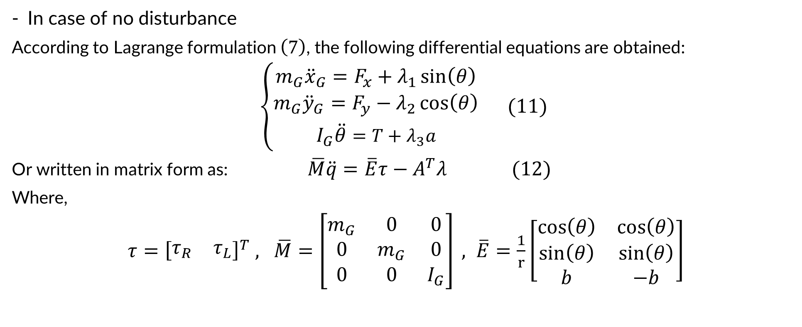
2. System modeling
B. WMR system model:
2. Dynamic model
In case of no disturbance
According to Lagrange formulation $\left(7\right)$, the following differential equations are obtained:
$\left\{\begin{aligned}{m_{G}\ddot{x}}_{G}=F_{x}+λ_{1}\sin\left(θ\right) \\ m_{G}{\ddot{y}}_{G}=F_{y}−λ_{2}\cos\left(θ\right) \\ I_{G}\ddot{θ}=T+λ_{3}a\end{aligned}\right. (11)$
Or written in matrix form as: $\overline{M}\ddot{q}=\overline{E}τ−A^{T}λ (12)$
Where,
$τ={\left[\begin{matrix}τ_{R} & τ_{L}\end{matrix}\right]}^{T} , \overline{M}=\left[\begin{matrix}m_{G} & 0 & 0 \\ 0 & m_{G} & 0 \\ 0 & 0 & I_{G}\end{matrix}\right] , \overline{E}=\frac{1}{r}\left[\begin{matrix}\cos\left(θ\right) & \cos\left(θ\right) \\ \sin\left(θ\right) & \sin\left(θ\right) \\ b & −b\end{matrix}\right]$

Slide 14
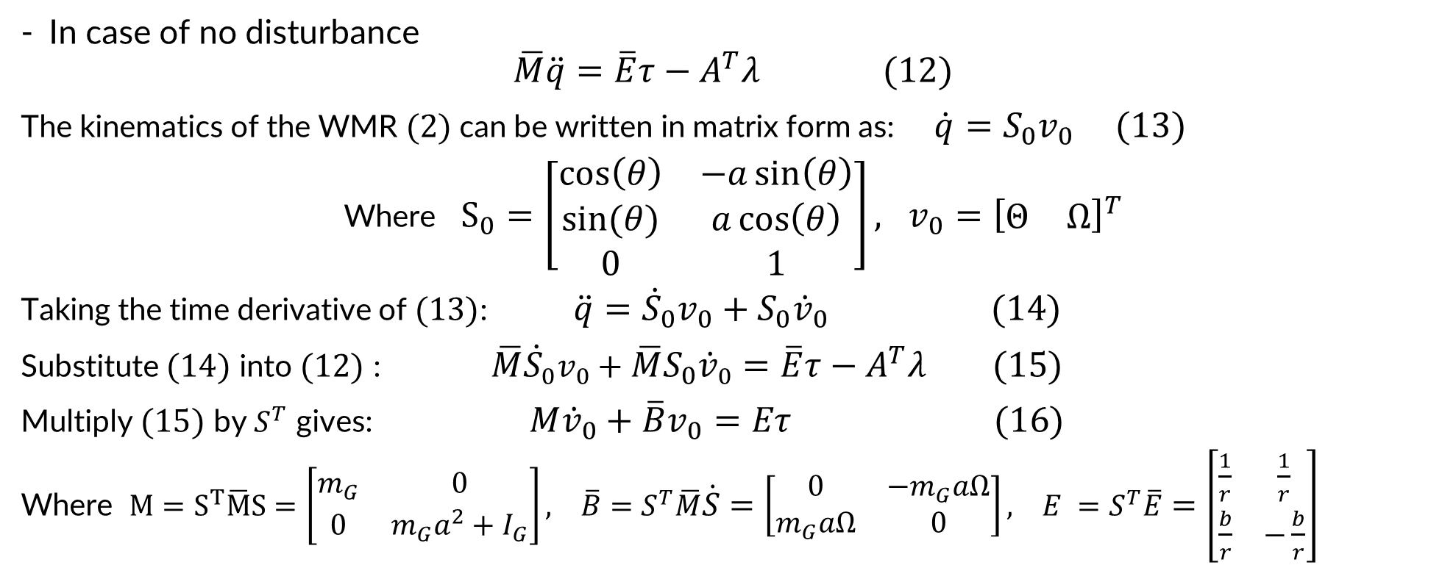
2. System modeling
B. WMR system model:
2. Dynamic model
In case of no disturbance
$$\overline{M}\ddot{q}=\overline{E}τ−A^{T}λ (12)$$
The kinematics of the WMR $(2)$can be written in matrix form as: $\dot{q}=S_{0}v_{0} (13)$
Where $S_{0}=\left[\begin{matrix}\cos\left(θ\right) & −a\sin\left(θ\right) \\ sin⁡(θ) & a\cos\left(θ\right) \\ 0 & 1\end{matrix}\right], v_{0}={\left[\begin{matrix}Θ & Ω\end{matrix}\right]}^{T}$
Taking the time derivative of $(13)$: $\ddot{q}={\dot{S}}_{0}v_{0}+S_{0}{\dot{v}}_{0} (14)$
Substitute $(14)$ into $(12)$ : $\overline{M}{\dot{S}}_{0}v_{0}+\overline{M}S_{0}{\dot{v}}_{0}=\overline{E}τ−A^{T}λ (15)$
Multiply $(15)$ by $S^{T}$ gives: $M{\dot{v}}_{0}+\overline{B}v_{0}=Eτ (16)$
Where $M=S^{T}\overline{M}S=\left[\begin{matrix}m_{G} & 0 \\ 0 & m_{G}a^{2}+I_{G}\end{matrix}\right], \overline{B}=S^{T}\overline{M}\dot{S}=\left[\begin{matrix}0 & −m_{G}aΩ \\ m_{G}aΩ & 0\end{matrix}\right], E =S^{T}\overline{E}=\left[\begin{matrix}\frac{1}{r} & \frac{1}{r} \\ \frac{b}{r} & −\frac{b}{r}\end{matrix}\right]$

Slide 15
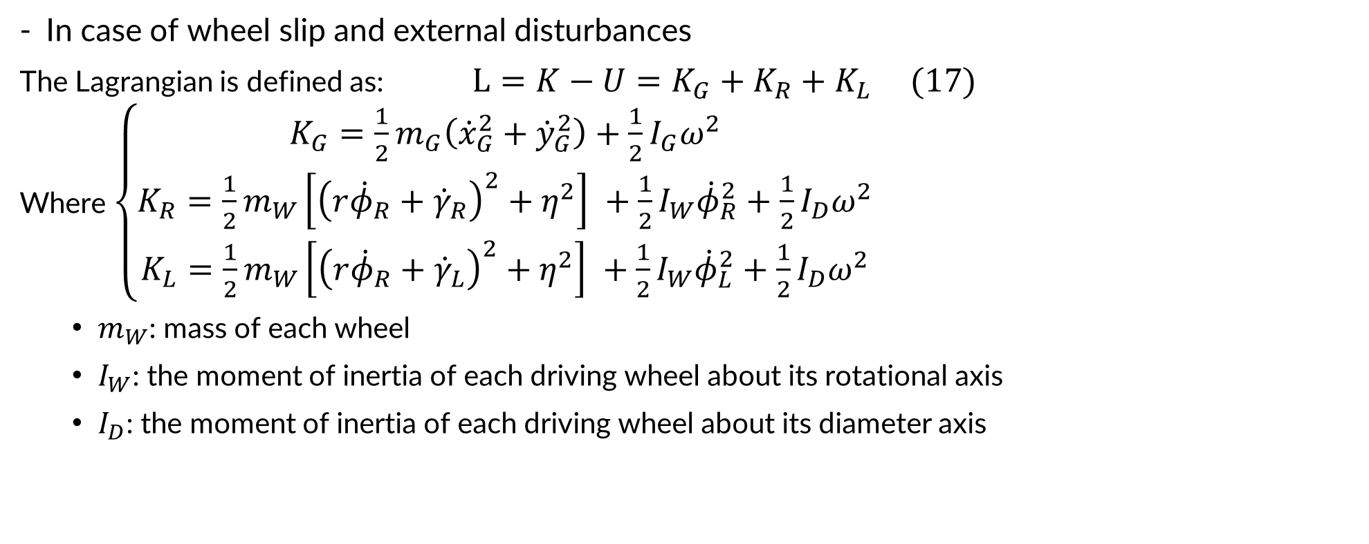
2. System modeling
B. WMR system model:
2. Dynamic model
In case of wheel slip and external disturbances
The Lagrangian is defined as: $L=K−U=K_{G}+K_{R}+K_{L} (17)$
Where $\left.\left\{\begin{aligned}\begin{aligned}K_{G}=\frac{1}{2}m_{G}\left({\dot{x}}_{G}^{2}+{\dot{y}}_{G}^{2}\right)+\frac{1}{2}I_{G}ω^{2} \\ K_{R}=\frac{1}{2}m_{W}\left[{\left({r\dot{φ}}_{R}+{\dot{γ}}_{R}\right)}^{2}+η^{2}\right] +\frac{1}{2}I_{W}{\dot{φ}}_{R}^{2}+\frac{1}{2}I_{D}ω^{2} \\ K_{L}=\frac{1}{2}m_{W}\left[{\left({r\dot{φ}}_{R}+{\dot{γ}}_{L}\right)}^{2}+η^{2}\right] +\frac{1}{2}I_{W}{\dot{φ}}_{L}^{2}+\frac{1}{2}I_{D}ω^{2}\end{aligned}\end{aligned}\right.\right.$
$m_{W}$: mass of each wheel
$I_{W}$: the moment of inertia of each driving wheel about its rotational axis
$I_{D}$: the moment of inertia of each driving wheel about its diameter axis
: the kinetic energy of the WMR platform.
: the kinetic energy of the right wheel.
: the kinetic energy of the left wheel.

Slide 16
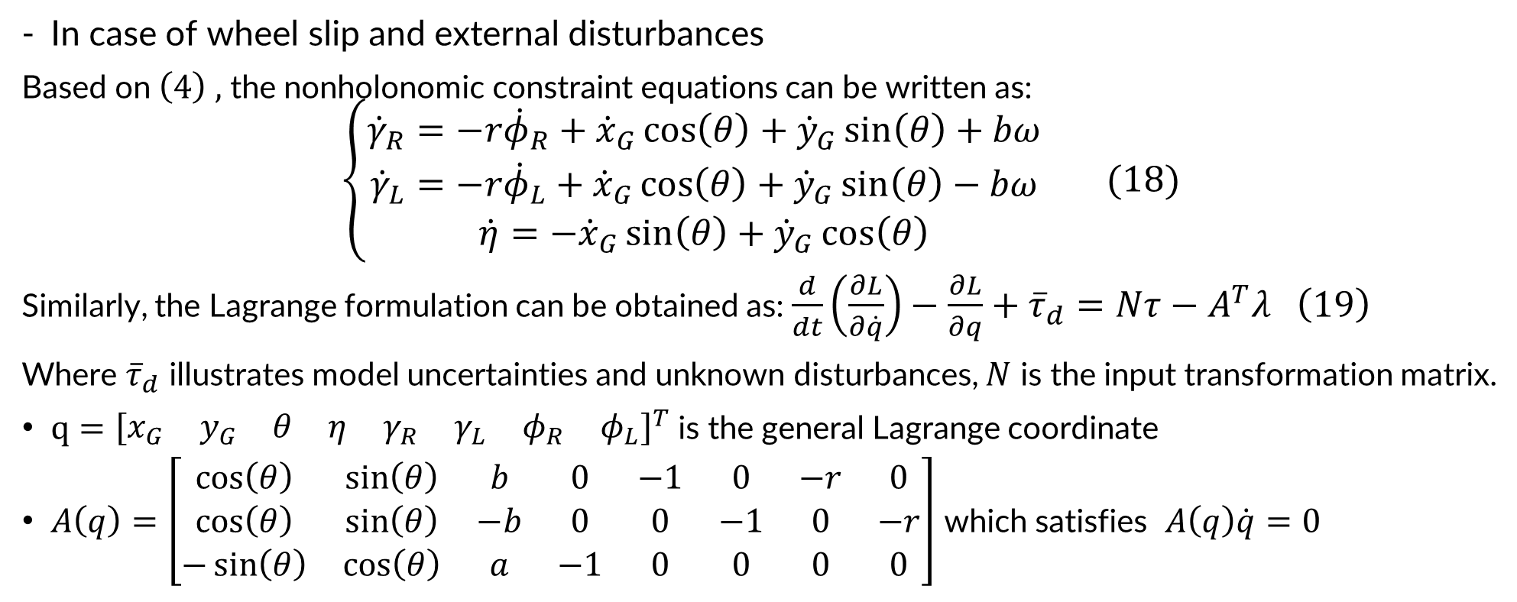
2. System modeling
B. WMR system model:
2. Dynamic model
In case of wheel slip and external disturbances
Based on $\left(4\right) ,$ the nonholonomic constraint equations can be written as:
$$\left\{\begin{aligned}{\dot{γ}}_{R}=−r{\dot{φ}}_{R}+{\dot{x}}_{G}\cos\left(θ\right)+{\dot{y}}_{G}\sin\left(θ\right)+bω \\ {\dot{γ}}_{L}=−r{\dot{φ}}_{L}+{\dot{x}}_{G}\cos\left(θ\right)+{\dot{y}}_{G}\sin\left(θ\right)−bω \\ \dot{η}=−{\dot{x}}_{G}\sin\left(θ\right)+{\dot{y}}_{G}\cos\left(θ\right)\end{aligned}\right. (18)$$
Similarly, the Lagrange formulation can be obtained as: $\frac{d}{dt}\left(\frac{∂L}{∂\dot{q}}\right)−\frac{∂L}{∂q}+{\overline{τ}}_{d}=Nτ−A^{T}λ \left(19\right)$
Where ${\overline{τ}}_{d}$ illustrates model uncertainties and unknown disturbances, $N$ is the input transformation matrix.
$q={\left[\begin{matrix}x_{G} & y_{G} & θ & η & γ_{R} & γ_{L} & φ_{R} & φ_{L}\end{matrix}\right]}^{T}$is the general Lagrange coordinate
$A\left(q\right)=\left[\begin{matrix}\cos\left(θ\right) & \sin\left(θ\right) & b & 0 & −1 & 0 & −r & 0 \\ \cos\left(θ\right) & \sin\left(θ\right) & −b & 0 & 0 & −1 & 0 & −r \\ −\sin\left(θ\right) & \cos\left(θ\right) & a & −1 & 0 & 0 & 0 & 0\end{matrix}\right]$ which satisfies $A\left(q\right)\dot{q}=0$

Slide 17
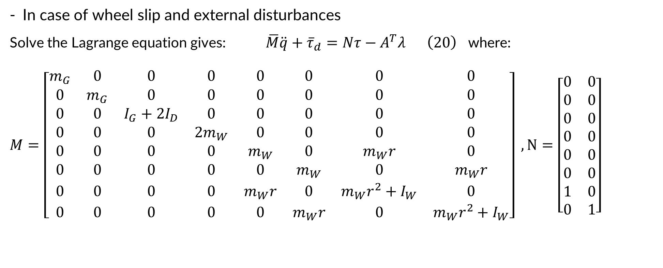
2. System modeling
B. WMR system model:
2. Dynamic model
In case of wheel slip and external disturbances
Solve the Lagrange equation gives: $\overline{M}\ddot{q}+{\overline{τ}}_{d}=Nτ−A^{T}λ \left(20\right)$ where:
$$M=\left[\begin{matrix}m_{G} & 0 & 0 & 0 & 0 & 0 & 0 & 0 \\ 0 & m_{G} & 0 & 0 & 0 & 0 & 0 & 0 \\ 0 & 0 & I_{G}+2I_{D} & 0 & 0 & 0 & 0 & 0 \\ 0 & 0 & 0 & 2m_{W} & 0 & 0 & 0 & 0 \\ 0 & 0 & 0 & 0 & m_{W} & 0 & m_{W}r & 0 \\ 0 & 0 & 0 & 0 & 0 & m_{W} & 0 & m_{W}r \\ 0 & 0 & 0 & 0 & m_{W}r & 0 & m_{W}r^{2}+I_{W} & 0 \\ 0 & 0 & 0 & 0 & 0 & m_{W}r & 0 & m_{W}r^{2}+I_{W}\end{matrix}\right] , N=\left[\begin{matrix}0 & 0 \\ 0 & 0 \\ 0 & 0 \\ 0 & 0 \\ 0 & 0 \\ 0 & 0 \\ 1 & 0 \\ 0 & 1\end{matrix}\right]$$

Slide 18
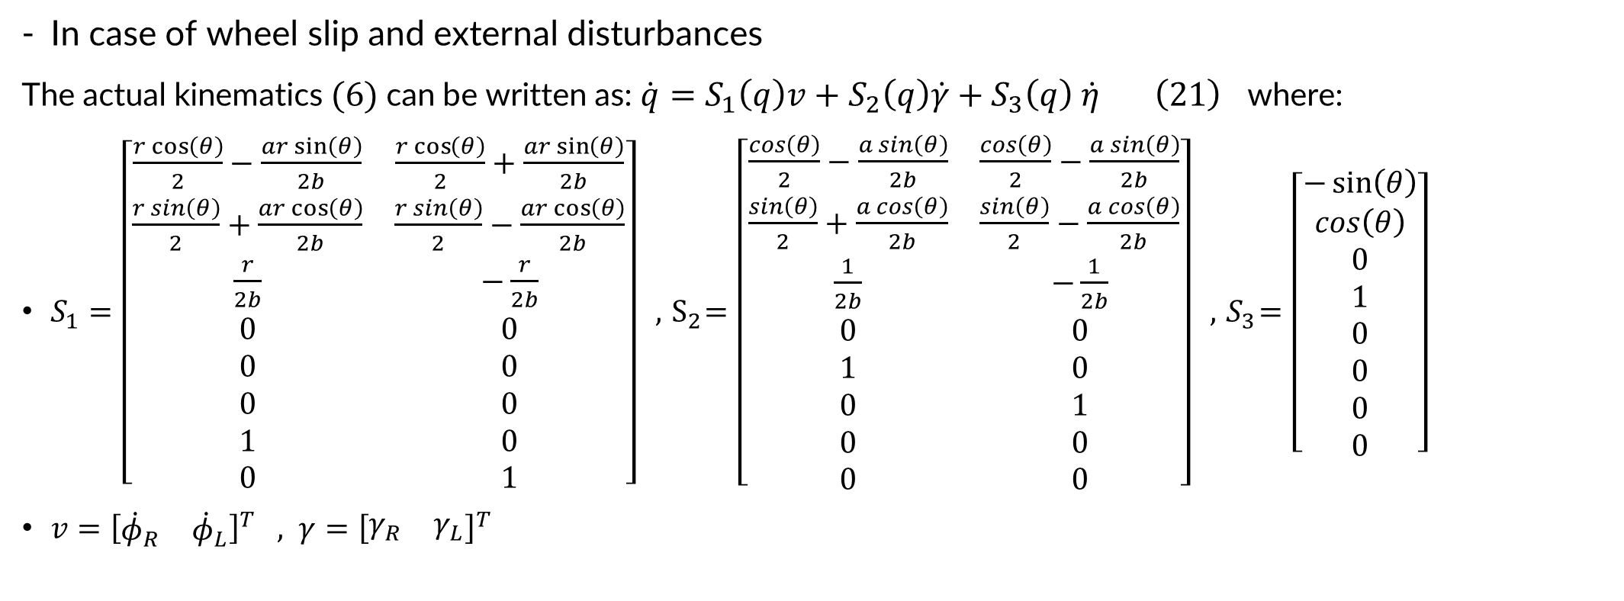
2. System modeling
B. WMR system model:
2. Dynamic model
In case of wheel slip and external disturbances
The actual kinematics $(6)$can be written as: $\dot{q}=S_{1}\left(q\right)v+S_{2}\left(q\right)\dot{γ}+S_{3}\left(q\right) \dot{η} \left(21\right)$ where:
$S_{1}=\left[\begin{matrix}\frac{r\cos\left(θ\right)}{2}−\frac{ar\sin\left(θ\right)}{2b} & \frac{r\cos\left(θ\right)}{2}+\frac{ar\sin\left(θ\right)}{2b} \\ \frac{r\sin\left(θ\right)}{2}+\frac{ar\cos\left(θ\right)}{2b} & \frac{r\sin\left(θ\right)}{2}−\frac{ar\cos\left(θ\right)}{2b} \\ \frac{r}{2b} & −\frac{r}{2b} \\ 0 & 0 \\ 0 & 0 \\ 0 & 0 \\ 1 & 0 \\ 0 & 1\end{matrix}\right] , { S}_{2}=\left[\begin{matrix}\frac{\cos\left(θ\right)}{2}−\frac{a\sin\left(θ\right)}{2b} & \frac{\cos\left(θ\right)}{2}−\frac{a\sin\left(θ\right)}{2b} \\ \frac{\sin\left(θ\right)}{2}+\frac{a\cos\left(θ\right)}{2b} & \frac{\sin\left(θ\right)}{2}−\frac{a\cos\left(θ\right)}{2b} \\ \frac{1}{2b} & −\frac{1}{2b} \\ 0 & 0 \\ 1 & 0 \\ 0 & 1 \\ 0 & 0 \\ 0 & 0\end{matrix}\right] , { S}_{3}=$ $\left[\begin{matrix}−\sin\left(θ\right) \\ \cos\left(θ\right) \\ 0 \\ 1 \\ 0 \\ 0 \\ 0 \\ 0\end{matrix}\right]$
$v={\left[\begin{matrix}{\dot{φ}}_{R} & {\dot{φ}}_{L}\end{matrix}\right]}^{T} , γ={\left[\begin{matrix}γ_{R} & γ_{L}\end{matrix}\right]}^{T}$

Slide 19
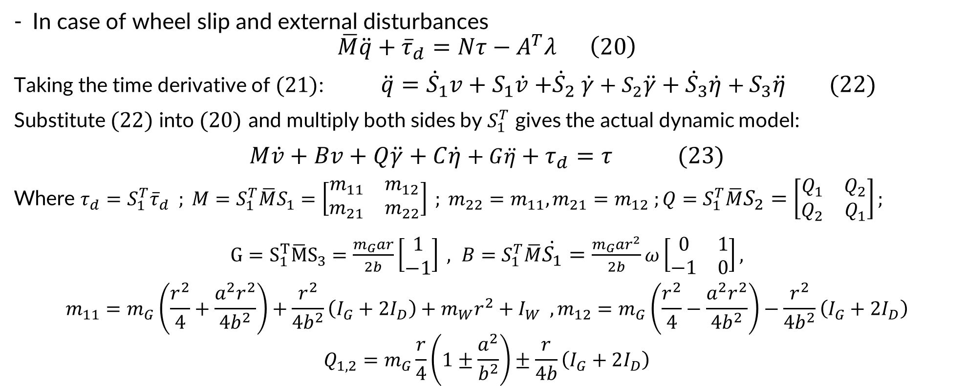
2. System modeling
B. WMR system model:
2. Dynamic model
In case of wheel slip and external disturbances
$$\overline{M}\ddot{q}+{\overline{τ}}_{d}=Nτ−A^{T}λ \left(20\right)$$
Taking the time derivative of $(21)$: $\ddot{q}={\dot{S}}_{1}v+S_{1}\dot{v}{+\dot{S}}_{2}\dot{γ}+S_{2}\ddot{γ}+{\dot{S}}_{3}\dot{η}+S_{3}\ddot{η} (22)$
Substitute $(22)$ into $(20)$ and multiply both sides by $S_{1}^{T}$ gives the actual dynamic model:
$M\dot{v}+Bv+Q\ddot{γ}+C\dot{η}+G\ddot{η}+τ_{d}=τ (23)$
Where $τ_{d}=S_{1}^{T}{\overline{τ}}_{d} ; M=S_{1}^{T}\overline{M}S_{1}=\left[\begin{matrix}m_{11} & m_{12} \\ m_{21} & m_{22}\end{matrix}\right] ; m_{22}=m_{11}, m_{21}=m_{12} ;Q=S_{1}^{T}\overline{M}S_{2}=\left[\begin{matrix}Q_{1} & Q_{2} \\ Q_{2} & Q_{1}\end{matrix}\right];$
$G=S_{1}^{T}\overline{M}S_{3}=\frac{m_{G}ar}{2b}\left[\begin{matrix}1 \\ −1\end{matrix}\right] , B=S_{1}^{T}\overline{M}\dot{S_{1}}=\frac{m_{G}ar^{2}}{2b}ω\left[\begin{matrix}0 & 1 \\ −1 & 0\end{matrix}\right],$
$$m_{11}=m_{G}\left(\frac{r^{2}}{4}+\frac{a^{2}r^{2}}{4b^{2}}\right)+\frac{r^{2}}{4b^{2}}\left(I_{G}+2I_{D}\right)+m_{W}r^{2}+I_{W} ,m_{12}=m_{G}\left(\frac{r^{2}}{4}−\frac{a^{2}r^{2}}{4b^{2}}\right)−\frac{r^{2}}{4b^{2}}\left(I_{G}+2I_{D}\right)$$
$$Q_{1,2}=m_{G}\frac{r}{4}\left(1±\frac{a^{2}}{b^{2}}\right)±\frac{r}{4b}\left(I_{G}+2I_{D}\right)$$

Slide 20
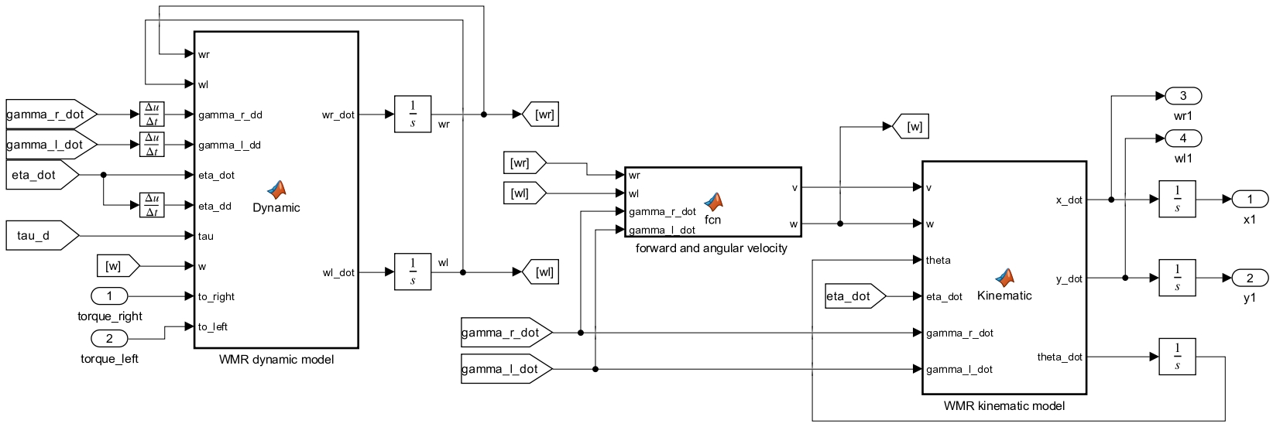
2. System modeling
C. WMR simulation implementation:

Slide 21
Multi-agent control design using traditional method ​

Slide 22
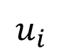
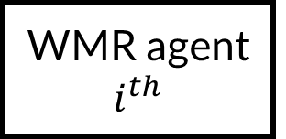
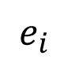
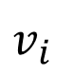
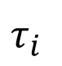
3. Multi-agent control using consensus algorithm
A. Control objective:
The consensus algorithm is utilized for agents with single-integrator and double-integrator dynamics to achieve common information states.
Distributed control law is implemented for each agent to ensure formation tracking while accurately following predefined trajectories.
➔ Apply the control algorithm to the WMR system.
Reference
+
$$e_{i}$$
Multi-agent controller
$$u_{i}$$
Feedback linearization
$$τ_{i}$$
WMR agent $i^{th}$
output
_
$$v_{i}$$
states

Slide 23
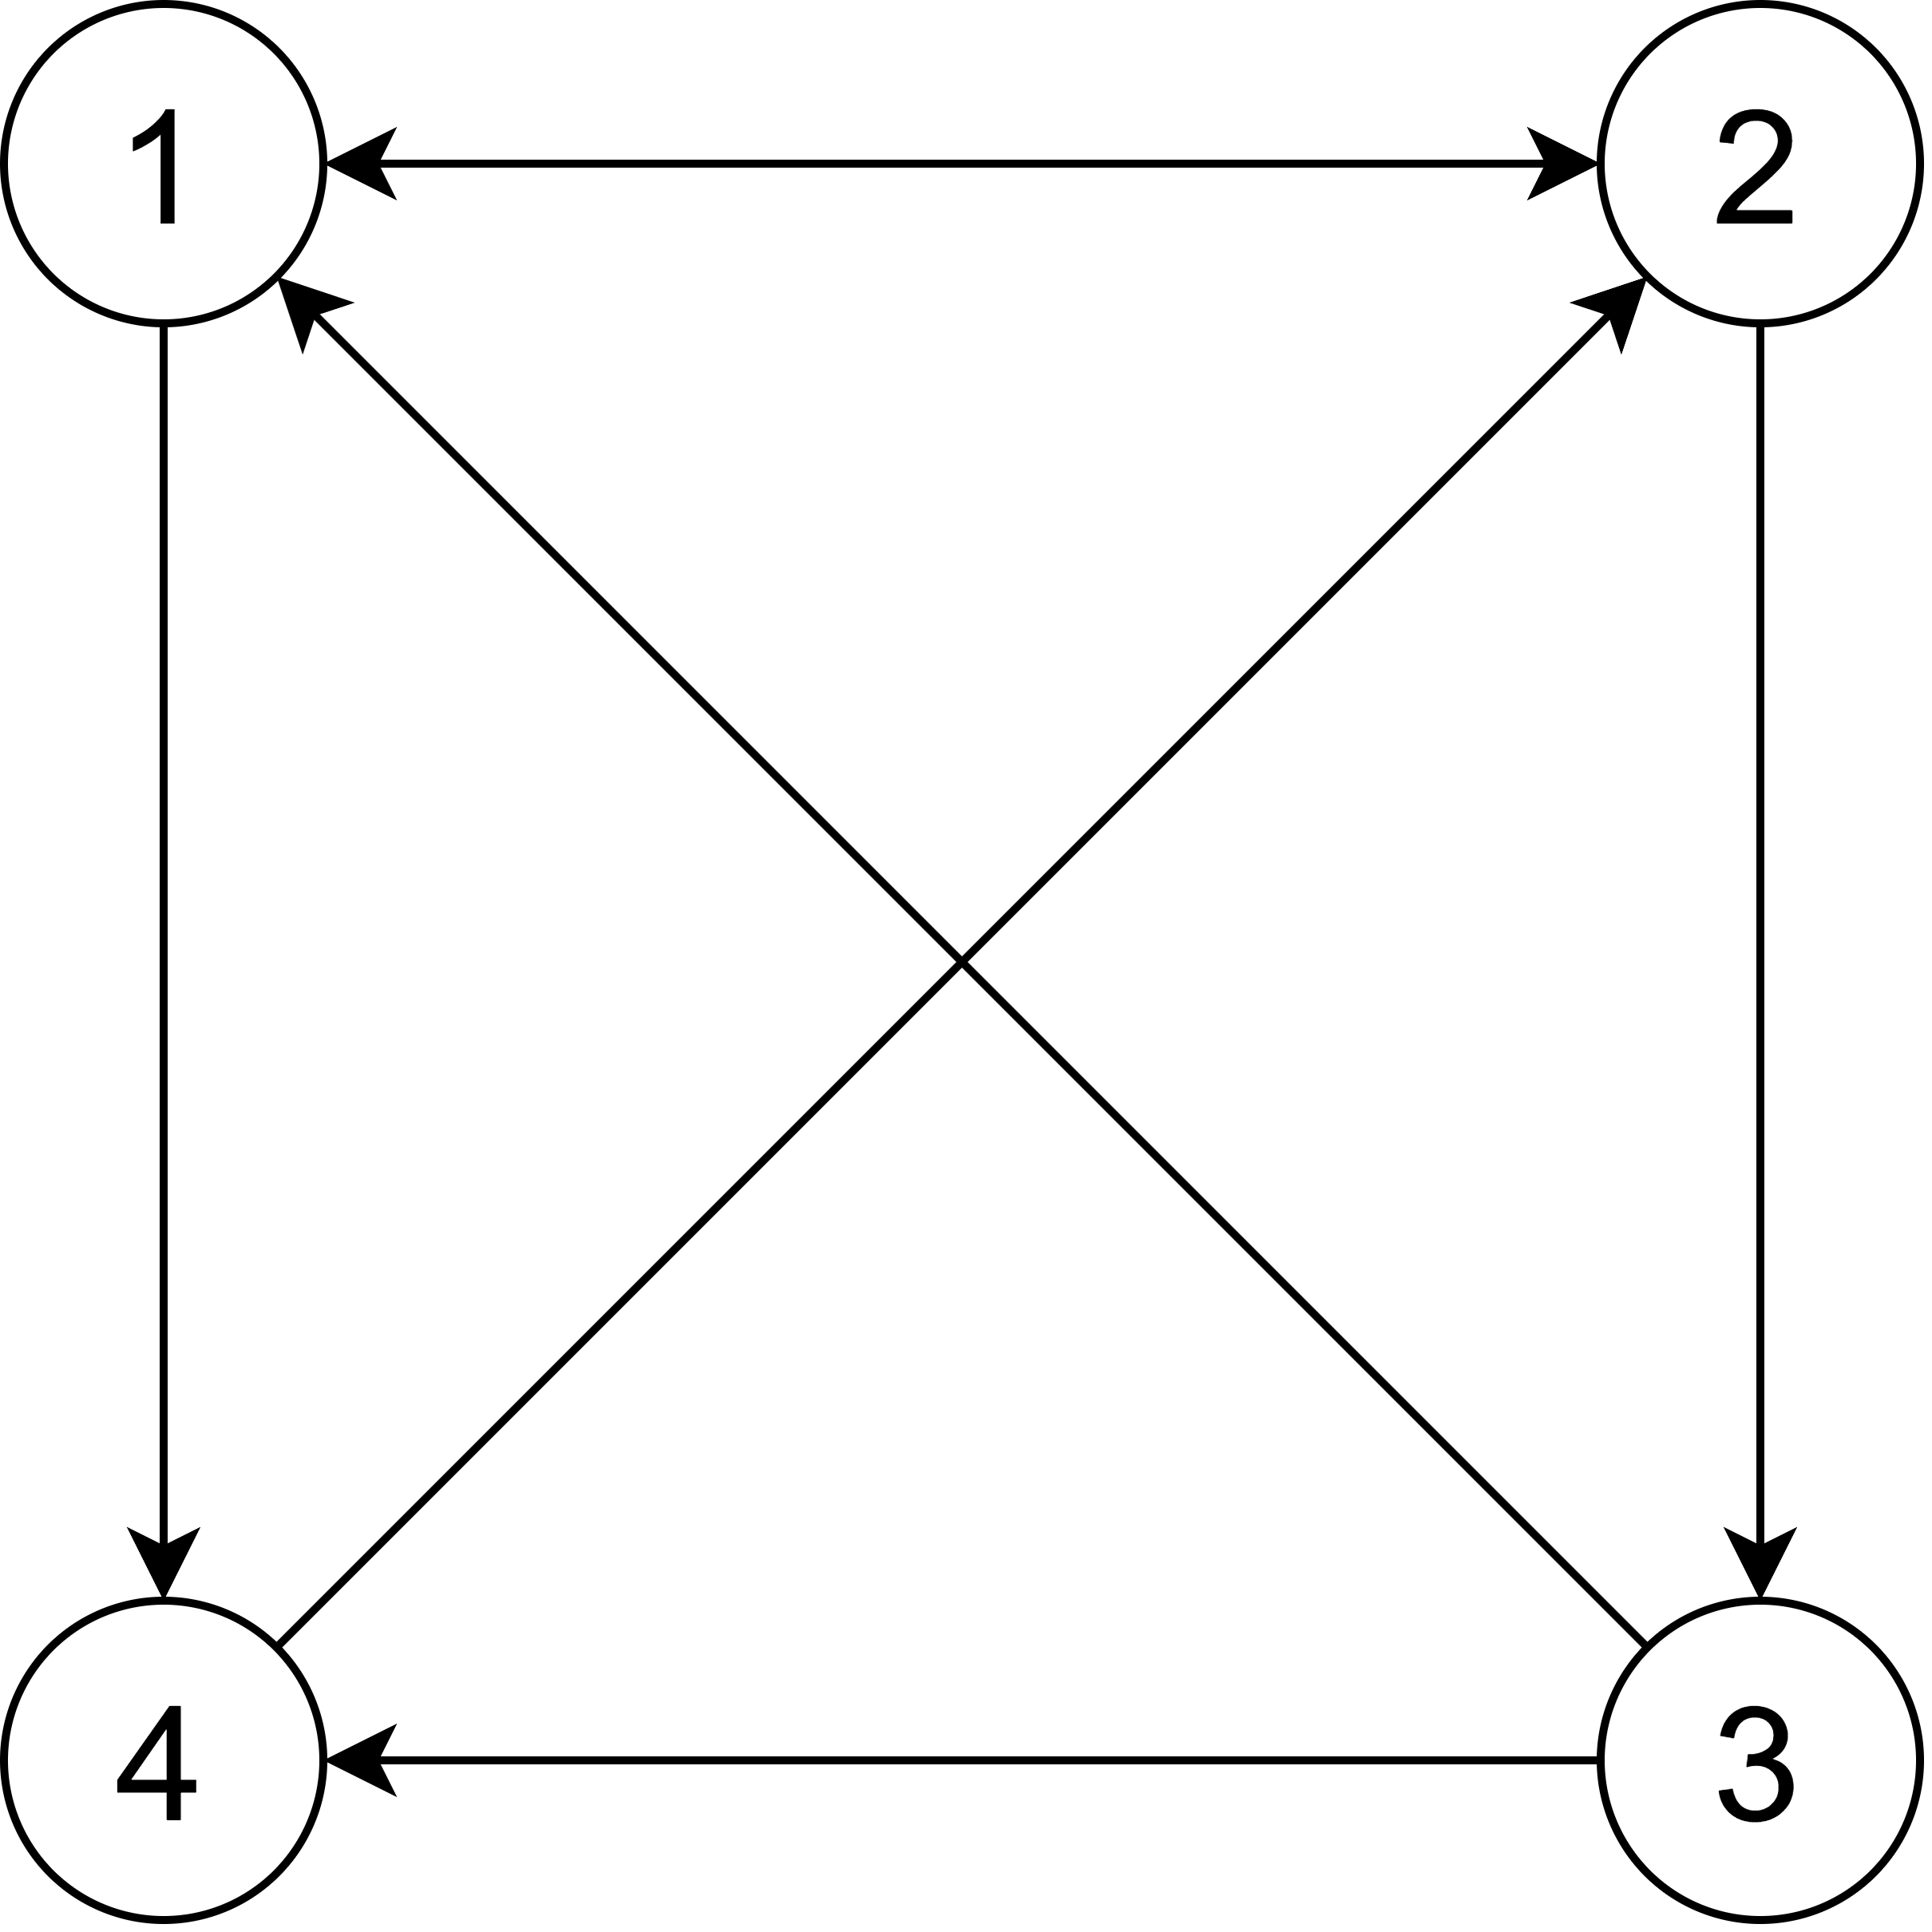
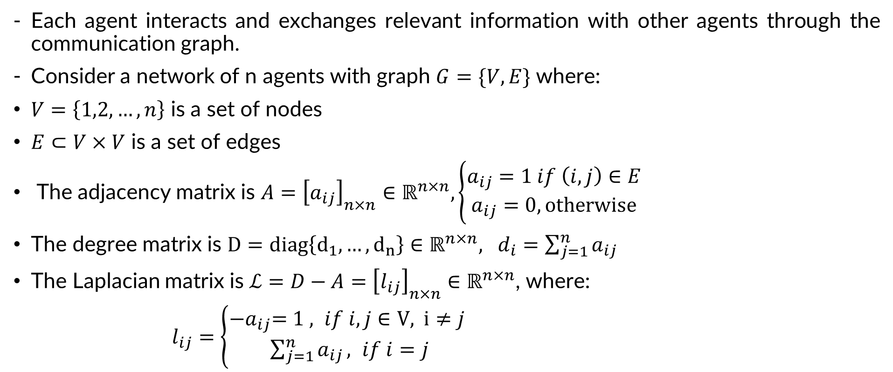
3. Multi-agent control using consensus algorithm
A. Control objective:
Each agent interacts and exchanges relevant information with other agents through the communication graph.
Consider a network of n agents with graph $G=\{V,E\}$ where:
$V=\left\{1,2,…,n\right\}$ is a set of nodes
$E⊂V×V$ is a set of edges
The adjacency matrix is $A={\left[a_{ij}\right]}_{n×n}∈ℝ^{n×n}, \left\{\begin{aligned}a_{ij}=1 if \left(i,j\right)∈E \\ a_{ij}=0, \text{otherwise} \end{aligned}\right.$
The degree matrix is $D=diag\left\{d_{1},…,d_{n}\right\}∈ℝ^{n×n}, d_{i}=\sum_{j=1}^{n}{a_{ij}}$
The Laplacian matrix is $ℒ=D−A={\left[l_{ij}\right]}_{n×n}∈ℝ^{n×n}$, where:
$l_{ij}=\left\{\begin{aligned}{−a}_{ij}=1 , if i,j∈\text{V}\text{, }\text{i}≠j \\ \sum_{j=1}^{n}{a_{ij}}, if i=j\end{aligned}\right.$
Interaction graph of 4 agents

Slide 24
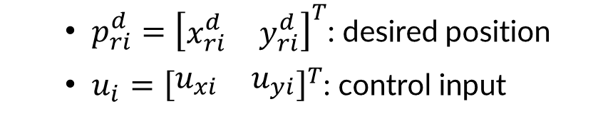
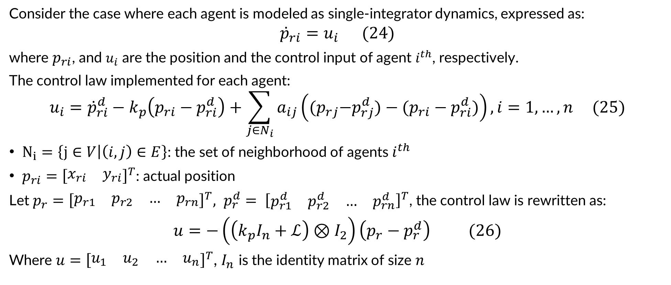
3. Multi-agent control using consensus algorithm
B. Consensus algorithm for single-integrator models:
Consider the case where each agent is modeled as single-integrator dynamics, expressed as:
$${\dot{p}}_{ri}=u_{i} (24)$$
where $p_{ri}$, and $u_{i}$ are the position and the control input of agent $i^{th}$, respectively.
The control law implemented for each agent:
$$u_{i}={\dot{p}}_{ri}^{d}−k_{p}\left(p_{ri}−p_{ri}^{d}\right)+\sum_{j∈N_{i}}{a_{ij}\left({(p}_{rj}−p_{rj}^{d})−(p_{ri}−p_{ri}^{d})\right),i=1,…,n (25)}$$
$N_{i}=\left\{j∈V | \left(i,j\right)∈E\right\}$: the set of neighborhood of agents $i^{th}$
$p_{ri}={\left[\begin{matrix}x_{ri} & y_{ri}\end{matrix}\right]}^{T}$: actual position
Let ${p_{r}=\left[\begin{matrix}p_{r1} & p_{r2} & … & p_{rn}\end{matrix}\right]}^{T}, {p_{r}^{d}= \left[\begin{matrix}p_{r1}^{d} & p_{r2}^{d} & … & p_{rn}^{d}\end{matrix}\right]}^{T}$, the control law is rewritten as:
$u=−\left(\left(k_{p}I_{n}+ℒ\right)⊗I_{2}\right)\left(p_{r}−p_{r}^{d}\right) (26)$
Where ${u=\left[\begin{matrix}u_{1} & u_{2} & … & u_{n}\end{matrix}\right]}^{T}$, $I_{n}$ is the identity matrix of size $n$
$p_{ri}^{d}={\left[\begin{matrix}x_{ri}^{d} & y_{ri}^{d}\end{matrix}\right]}^{T}$: desired position
$u_{i}={\left[\begin{matrix}u_{xi} & u_{yi}\end{matrix}\right]}^{T}$: control input

Slide 25
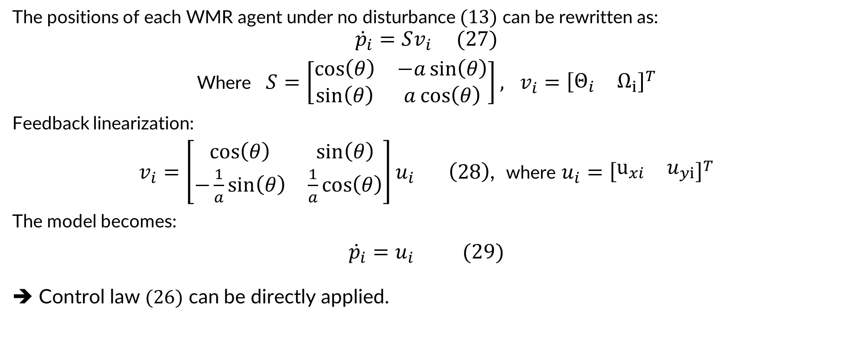
3. Multi-agent control using consensus algorithm
B. Consensus algorithm for single-integrator models:
The positions of each WMR agent under no disturbance $(13)$can be rewritten as:
$${\dot{p}}_{i}=Sv_{i} (27)$$
Where $S=\left[\begin{matrix}\cos\left(θ\right) & −a\sin\left(θ\right) \\ \sin\left(θ\right) & a\cos\left(θ\right)\end{matrix}\right], v_{i}={\left[\begin{matrix}Θ_{i} & Ω_{i}\end{matrix}\right]}^{T}$
Feedback linearization:
$v_{i}=\left[\begin{matrix}\cos\left(θ\right) & \sin\left(θ\right) \\ −\frac{1}{a}\sin\left(θ\right) & \frac{1}{a}\cos\left(θ\right)\end{matrix}\right]u_{i} \left(28\right)$, where $u_{i}={\left[\begin{matrix}u_{xi} & u_{yi}\end{matrix}\right]}^{T}$
The model becomes:
${\dot{p}}_{i}=u_{i} (29)$
➔ Control law $(26)$ can be directly applied.

Slide 26
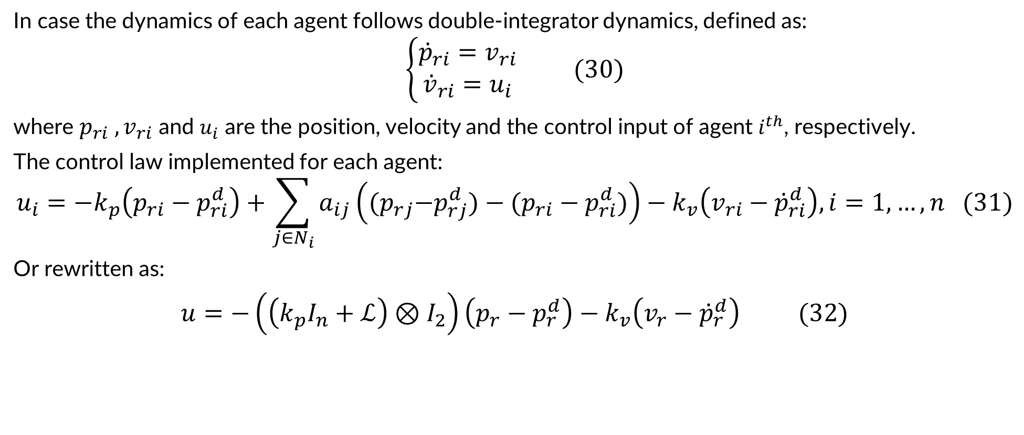
3. Multi-agent control using consensus algorithm
C. Consensus algorithm for double-integrator models:
In case the dynamics of each agent follows double-integrator dynamics, defined as:
$$\left\{\begin{aligned}{\dot{p}}_{ri}=v_{ri} \\ {\dot{v}}_{ri}=u_{i}\end{aligned}\right. (30)$$
where $p_{ri} , v_{ri}$ and $u_{i}$ are the position, velocity and the control input of agent $i^{th}$, respectively.
The control law implemented for each agent:
$$u_{i}=−k_{p}\left(p_{ri}−p_{ri}^{d}\right)+\sum_{j∈N_{i}}{a_{ij}\left({(p}_{rj}−p_{rj}^{d})−(p_{ri}−p_{ri}^{d})\right)−k_{v}\left(v_{ri}−{\dot{p}}_{ri}^{d}\right),i=1,…,n (31)}$$
Or rewritten as:
$u=−\left(\left(k_{p}I_{n}+ℒ\right)⊗I_{2}\right)\left(p_{r}−p_{r}^{d}\right)−k_{v}\left(v_{r}−{\dot{p}}_{r}^{d}\right) (32)$

Slide 27
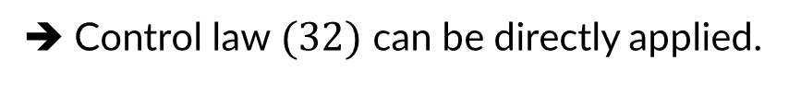
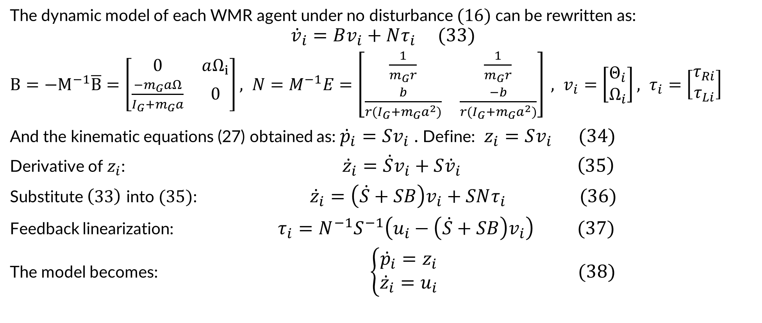
3. Multi-agent control using consensus algorithm
C. Consensus algorithm for double-integrator models:
The dynamic model of each WMR agent under no disturbance $(16)$can be rewritten as:
$${\dot{v}}_{i}=Bv_{i}+Nτ_{i} (33)$$
$B=−M^{−1}\overline{B}=\left[\begin{matrix}0 & aΩ_{i} \\ \frac{−m_{G}aΩ}{I_{G}+m_{G}a} & 0\end{matrix}\right], N=M^{−1}E=\left[\begin{matrix}\frac{1}{m_{G}r} & \frac{1}{m_{G}r} \\ \frac{b}{{r(I}_{G}+m_{G}a^{2})} & \frac{−b}{{r(I}_{G}+m_{G}a^{2})}\end{matrix}\right] , v_{i}=\left[\begin{matrix}Θ_{i} \\ Ω_{i}\end{matrix}\right], τ_{i}=\left[\begin{matrix}τ_{Ri} \\ τ_{Li}\end{matrix}\right]$
And the kinematic equations (27) obtained as: ${\dot{p}}_{i}=Sv_{i}$ . Define: $z_{i}=Sv_{i} (34)$
Derivative of $z_{i}$: ${\dot{z}}_{i}=\dot{S}v_{i}+S{\dot{v}}_{i} \left(35\right)$
Substitute $\left(33\right)$ into $(35)$: ${\dot{z}}_{i}=\left(\dot{S}+SB\right)v_{i}+SNτ_{i} (36)$
Feedback linearization: $τ_{i}=N^{−1}S^{−1}\left(u_{i}−\left(\dot{S}+SB\right)v_{i}\right) (37)$
The model becomes: $\left\{\begin{aligned}{\dot{p}}_{i}=z_{i} \\ {\dot{z}}_{i}=u_{i}\end{aligned}\right. (38)$
➔ Control law $(32)$ can be directly applied.

Slide 28
Multi-agent control design using Adaptive Dynamic Programming approach

Slide 29
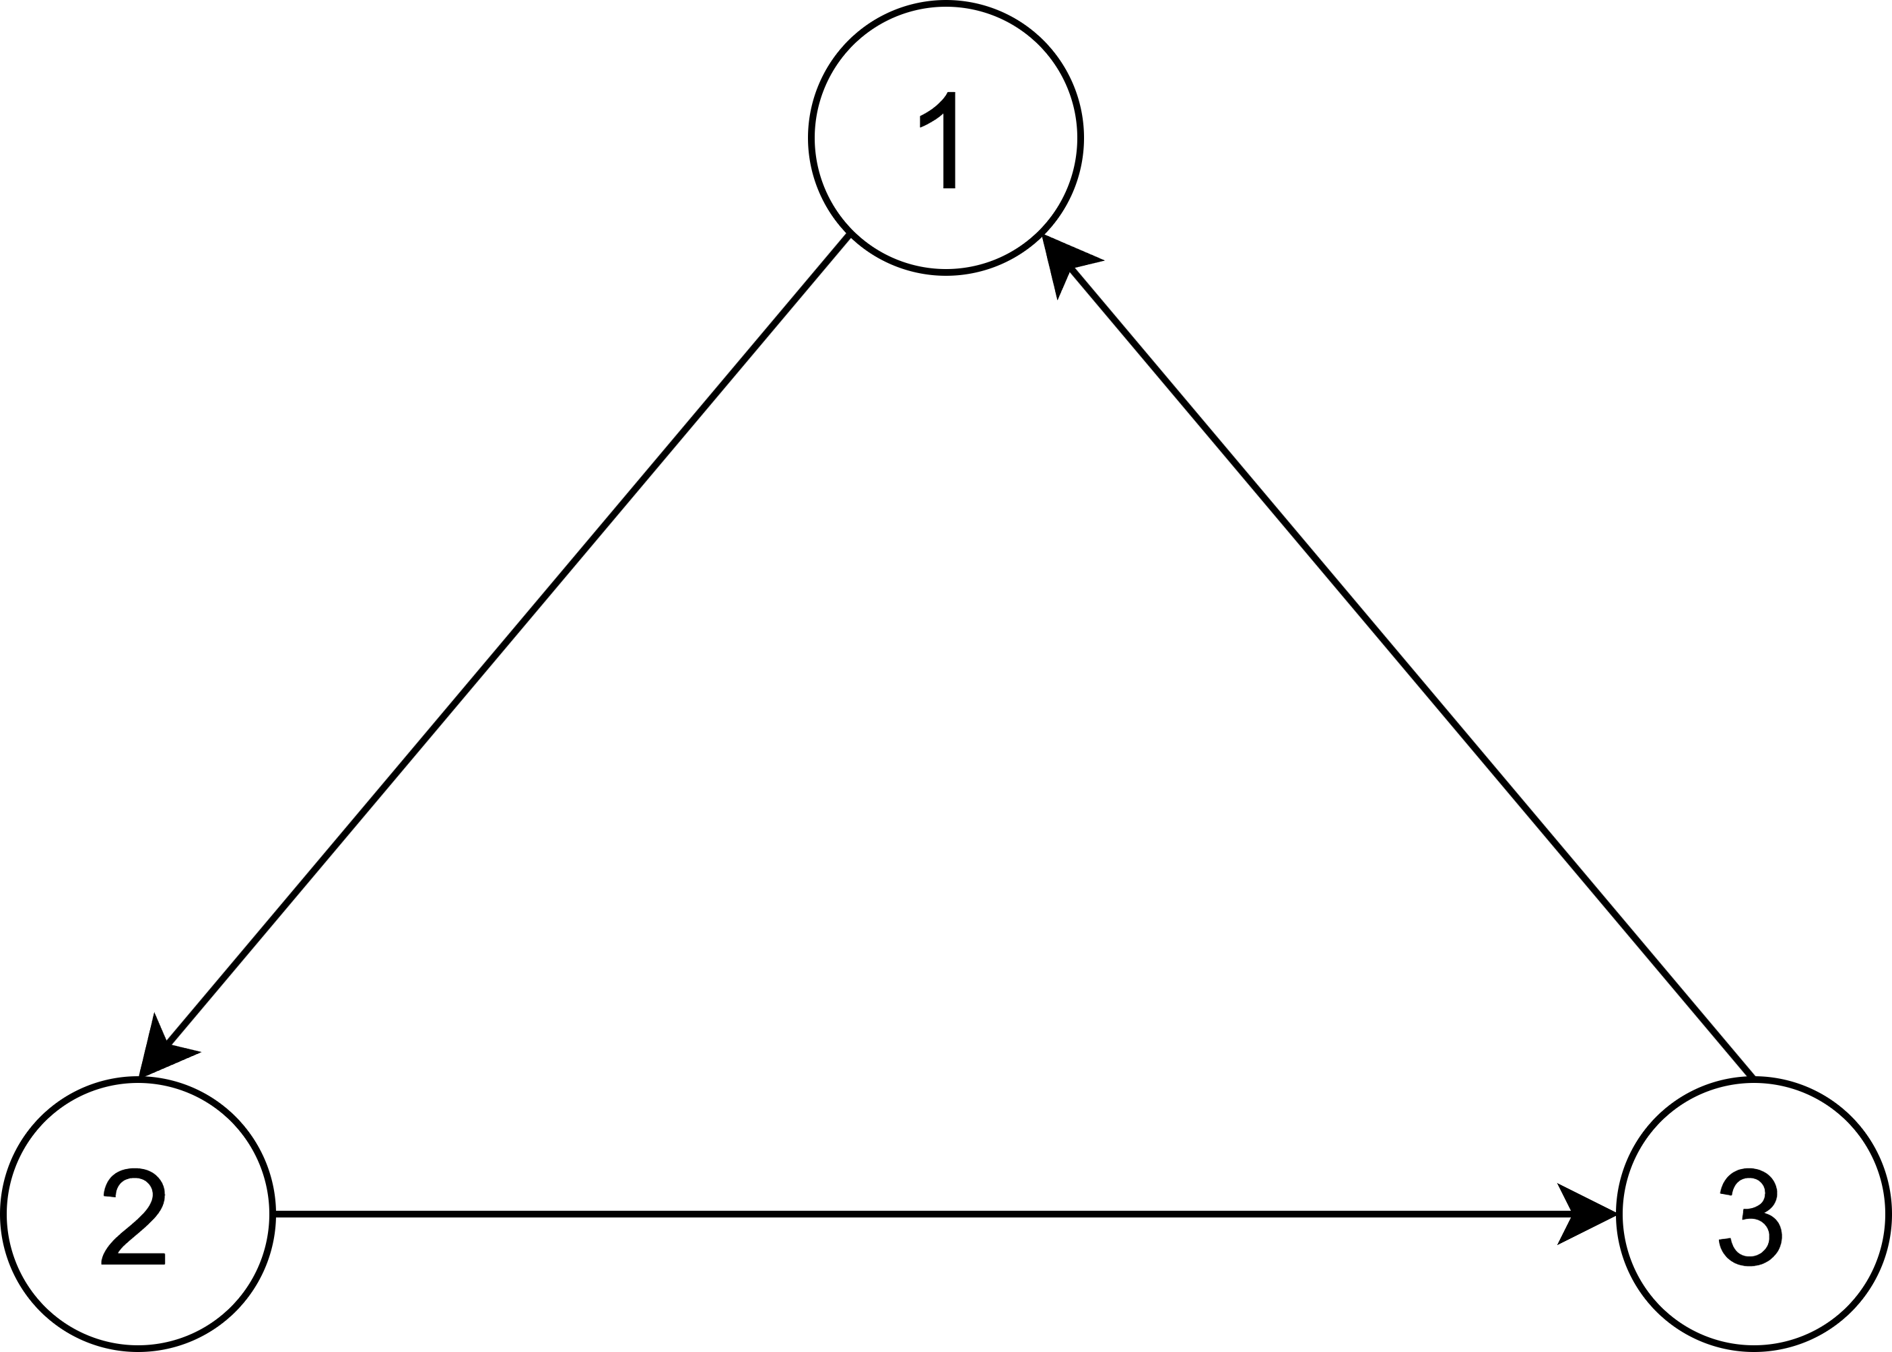
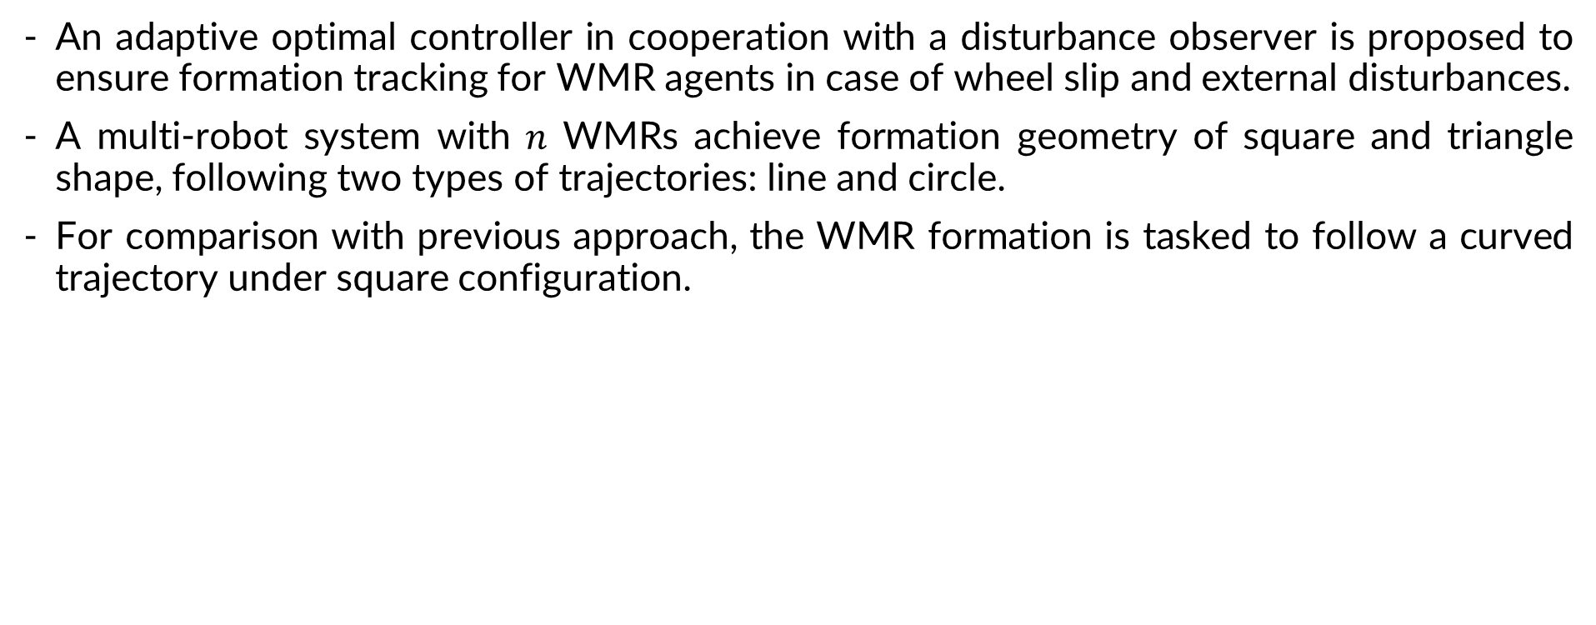
4. Multi-agent control using ADP approach
A. Control objective:
An adaptive optimal controller in cooperation with a disturbance observer is proposed to ensure formation tracking for WMR agents in case of wheel slip and external disturbances.
A multi-robot system with $n$ WMRs achieve formation geometry of square and triangle shape, following two types of trajectories: line and circle.
For comparison with previous approach, the WMR formation is tasked to follow a curved trajectory under square configuration.
Interaction topology considered

Slide 30
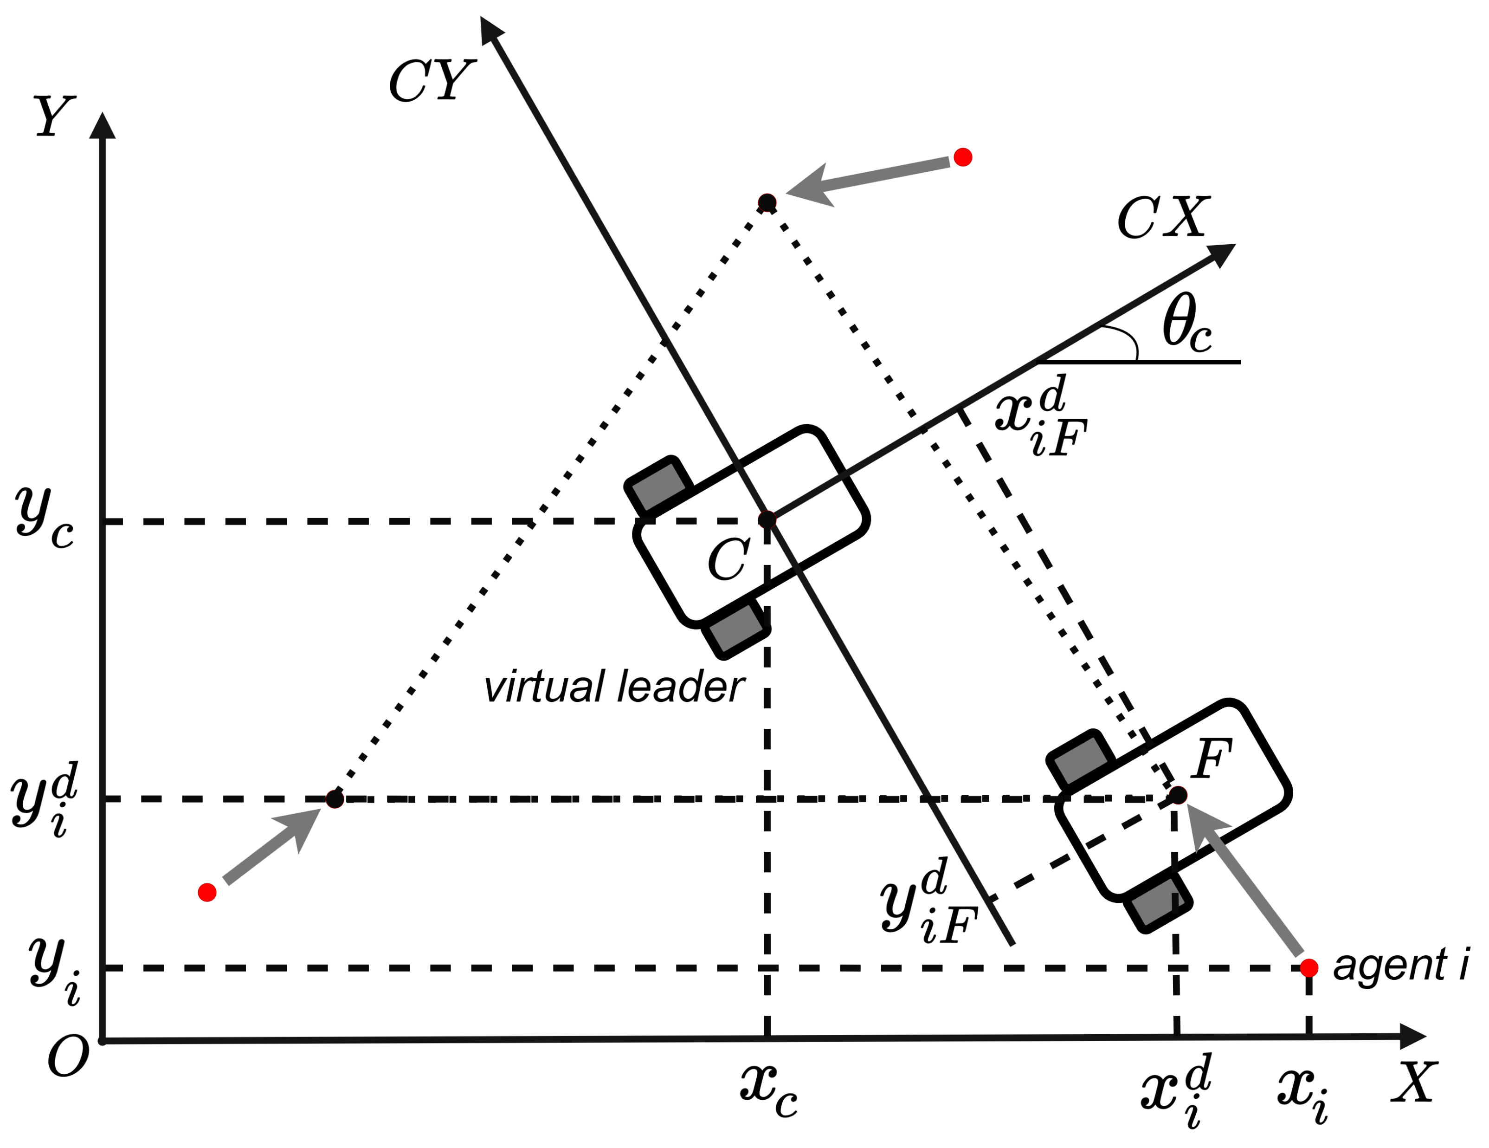
4. Multi-agent control using ADP approach
B. Problem formulation:
Virtual leader/structure approach.
Decentralized scheme instead of a centralized one.
Control approach:
+ Define the desired dynamics of the virtual leader or virtual structure.
+ The motion of the virtual leader is translated into desired motions for each robot.
+ Derive distributed tracking control laws for each robot.
Triangle formation with a known virtual leader

Slide 31
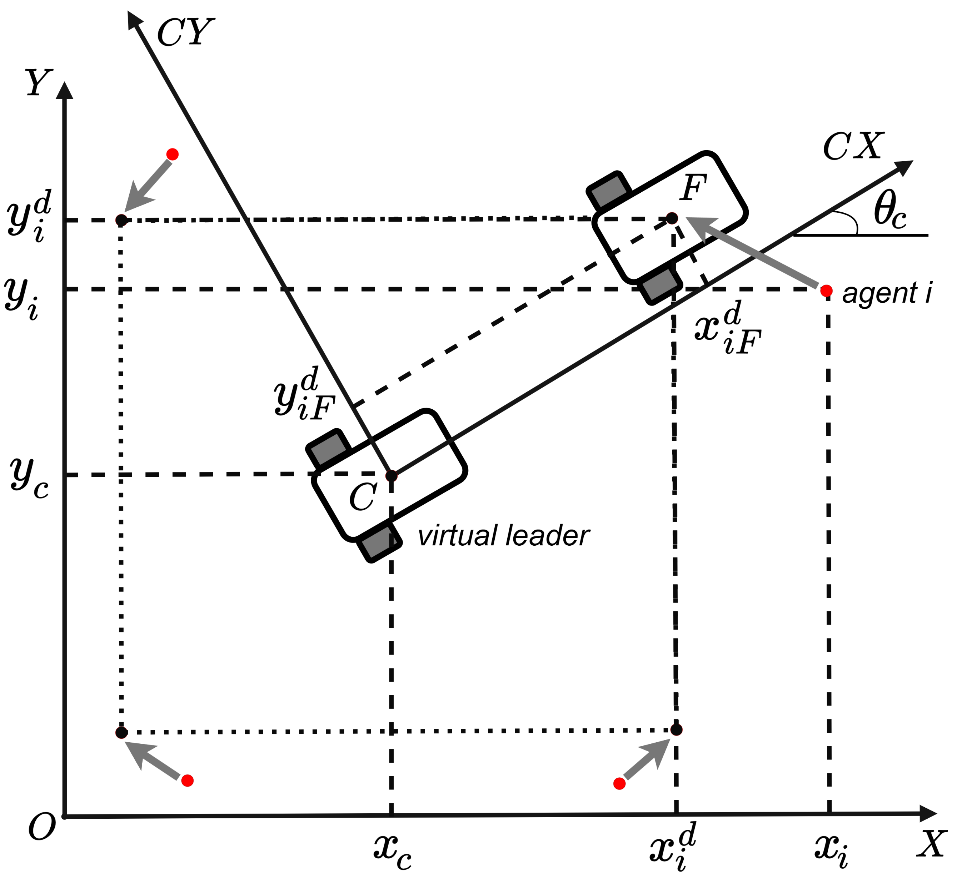
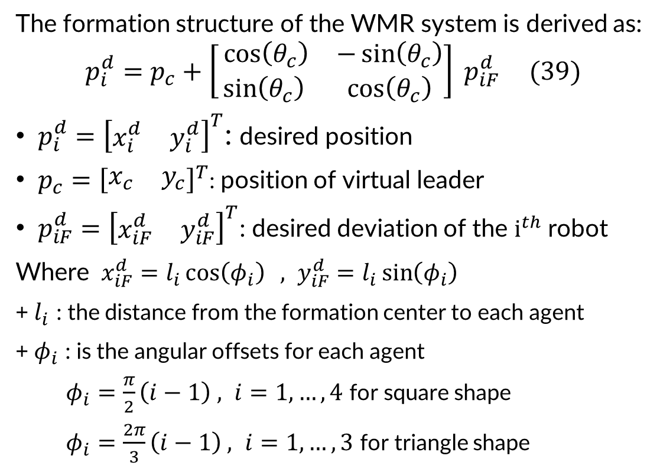
4. Multi-agent control using ADP approach
B. Problem formulation:
The formation structure of the WMR system is derived as:
$$p_{i}^{d}=p_{c}+\left[\begin{matrix}⁡\cos\left(θ_{c}\right) & −\sin\left(θ_{c}\right) \\ \sin\left(θ_{c}\right) & \cos\left(θ_{c}\right)\end{matrix}\right] p_{iF}^{d} (39)$$
$p_{i}^{d}={\left[\begin{matrix}x_{i}^{d} & y_{i}^{d}\end{matrix}\right]}^{T}$: desired position
$p_{c}={\left[\begin{matrix}x_{c} & y_{c}\end{matrix}\right]}^{T}$: position of virtual leader
$p_{iF}^{d}={\left[\begin{matrix}x_{iF}^{d} & y_{iF}^{d}\end{matrix}\right]}^{T}$: desired deviation of the $i^{th}$ robot
Where $x_{iF}^{d}=l_{i}\cos\left(φ_{i}\right) , y_{iF}^{d}=l_{i}\sin\left(φ_{i}\right)$
+${ l}_{i}$ : the distance from the formation center to each agent
+$φ_{i}$ : is the angular offsets for each agent
$φ_{i}=\frac{π}{2}\left(i−1\right) , i=1,…,4$ for square shape
$φ_{i}=\frac{2π}{3}\left(i−1\right) , i=1,…,3$ for triangle shape
Square formation with a known virtual leader
➔ Control law $(32)$ using consensus algorithm can be applied.

Slide 32
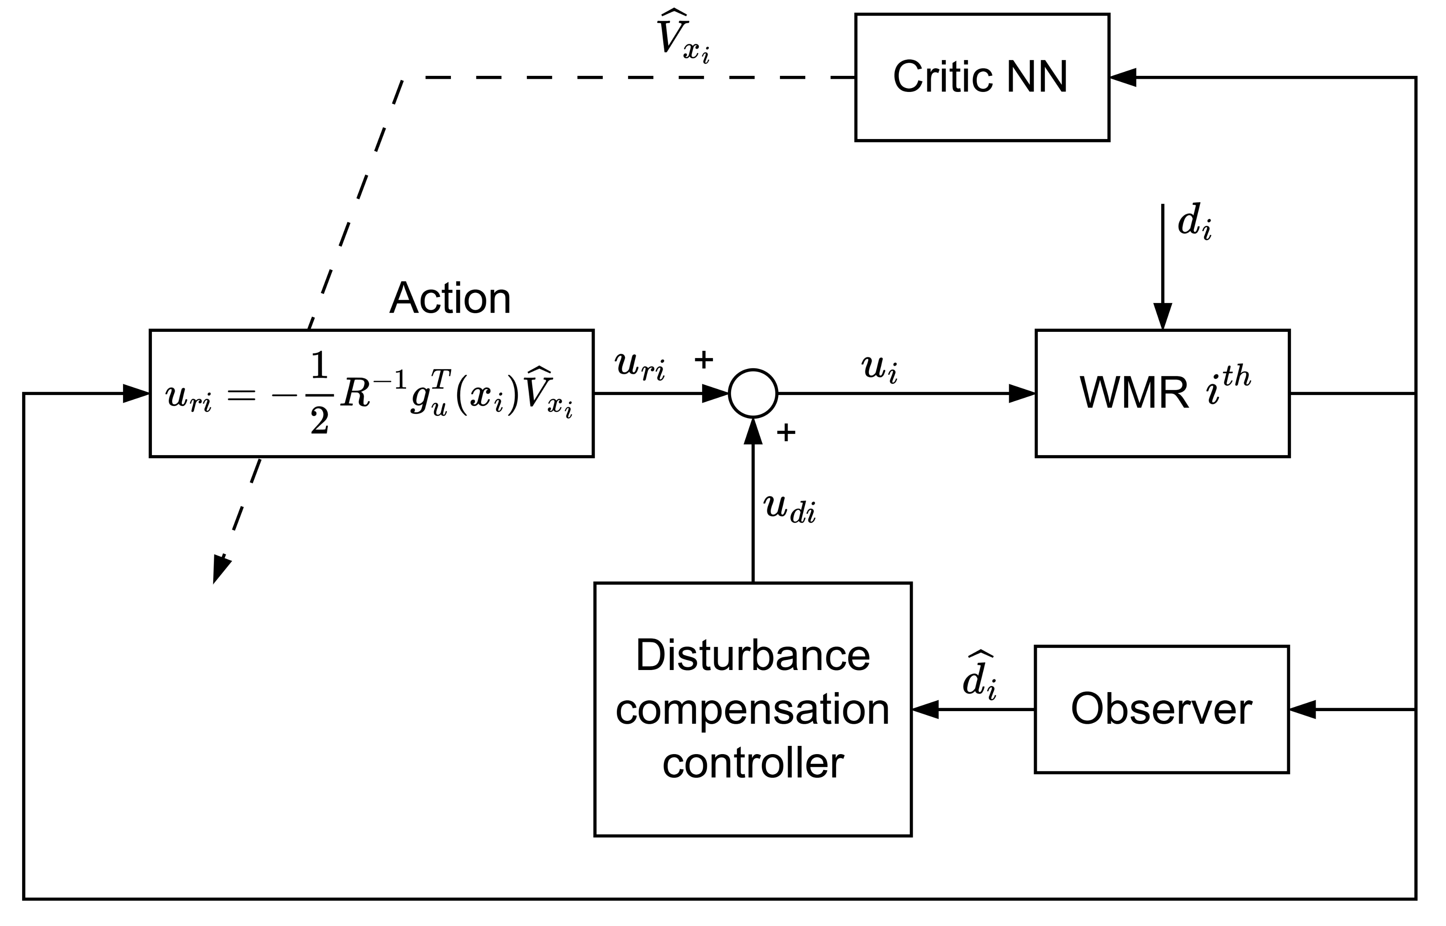
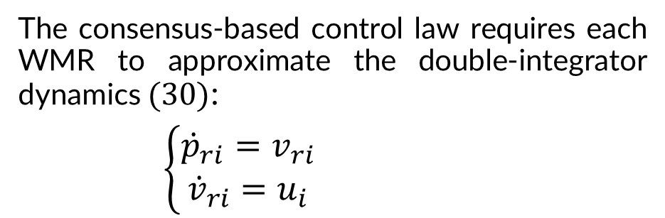
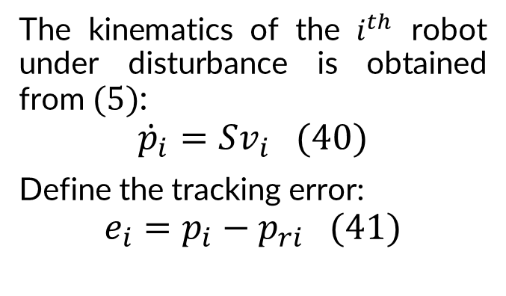
4. Multi-agent control using ADP approach
C. Tracking control design:
1. Control strategy
The consensus-based control law requires each WMR to approximate the double-integrator dynamics $(30)$:
$\left\{\begin{aligned}{\dot{p}}_{ri}=v_{ri} \\ {\dot{v}}_{ri}=u_{i}\end{aligned}\right.$
The kinematics of the $i^{th}$ robot under disturbance is obtained from $(5)$:
$${\dot{p}}_{i}=Sv_{i} (40)$$
Define the tracking error:
$$e_{i}=p_{i}−p_{ri} (41)$$
ADP control structure combined with disturbance observer

Slide 33
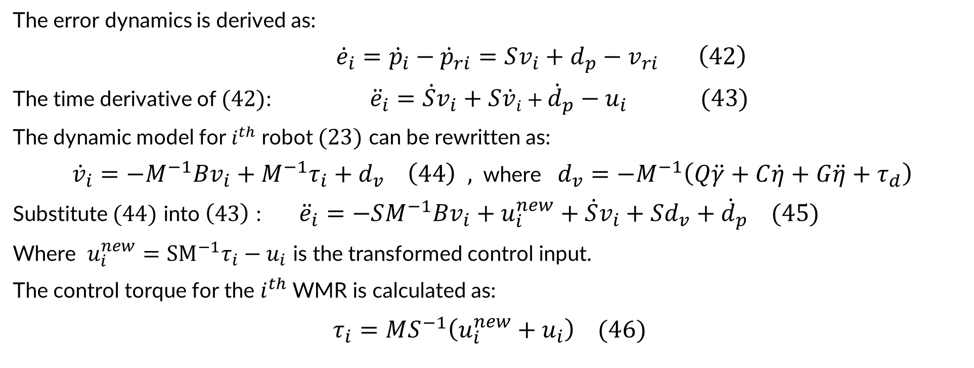
4. Multi-agent control using ADP approach
C. Tracking control design:
1. Control strategy
The error dynamics is derived as:
${\dot{e}}_{i}={\dot{p}}_{i}−{\dot{p}}_{ri}=Sv_{i}+d_{p}−v_{ri} \left(42\right)$
The time derivative of $(42)$: ${\ddot{e}}_{i}=\dot{S}v_{i}+S{\dot{v}}_{i}+{\dot{d}}_{p}−u_{i} (43)$
The dynamic model for $i^{th}$ robot $(23)$ can be rewritten as:
${\dot{v}}_{i}=−M^{−1}Bv_{i}+M^{−1}τ_{i}+d_{v} \left(44\right) ,$where $d_{v}=−M^{−1}\left(Q\ddot{γ}+C\dot{η}+G\ddot{η}+τ_{d}\right)$
Substitute $(44)$ into $\left(43\right)$ : ${\ddot{e}}_{i}=−SM^{−1}Bv_{i}+u_{i}^{new}+\dot{S}v_{i}+Sd_{v}+{\dot{d}}_{p} (45)$
Where $u_{i}^{new}={SM}^{−1}τ_{i}−u_{i}$ is the transformed control input.
The control torque for the $i^{th}$ WMR is calculated as:
$$τ_{i}=MS^{−1}\left(u_{i}^{new}+u_{i}\right) (46)$$

Slide 34
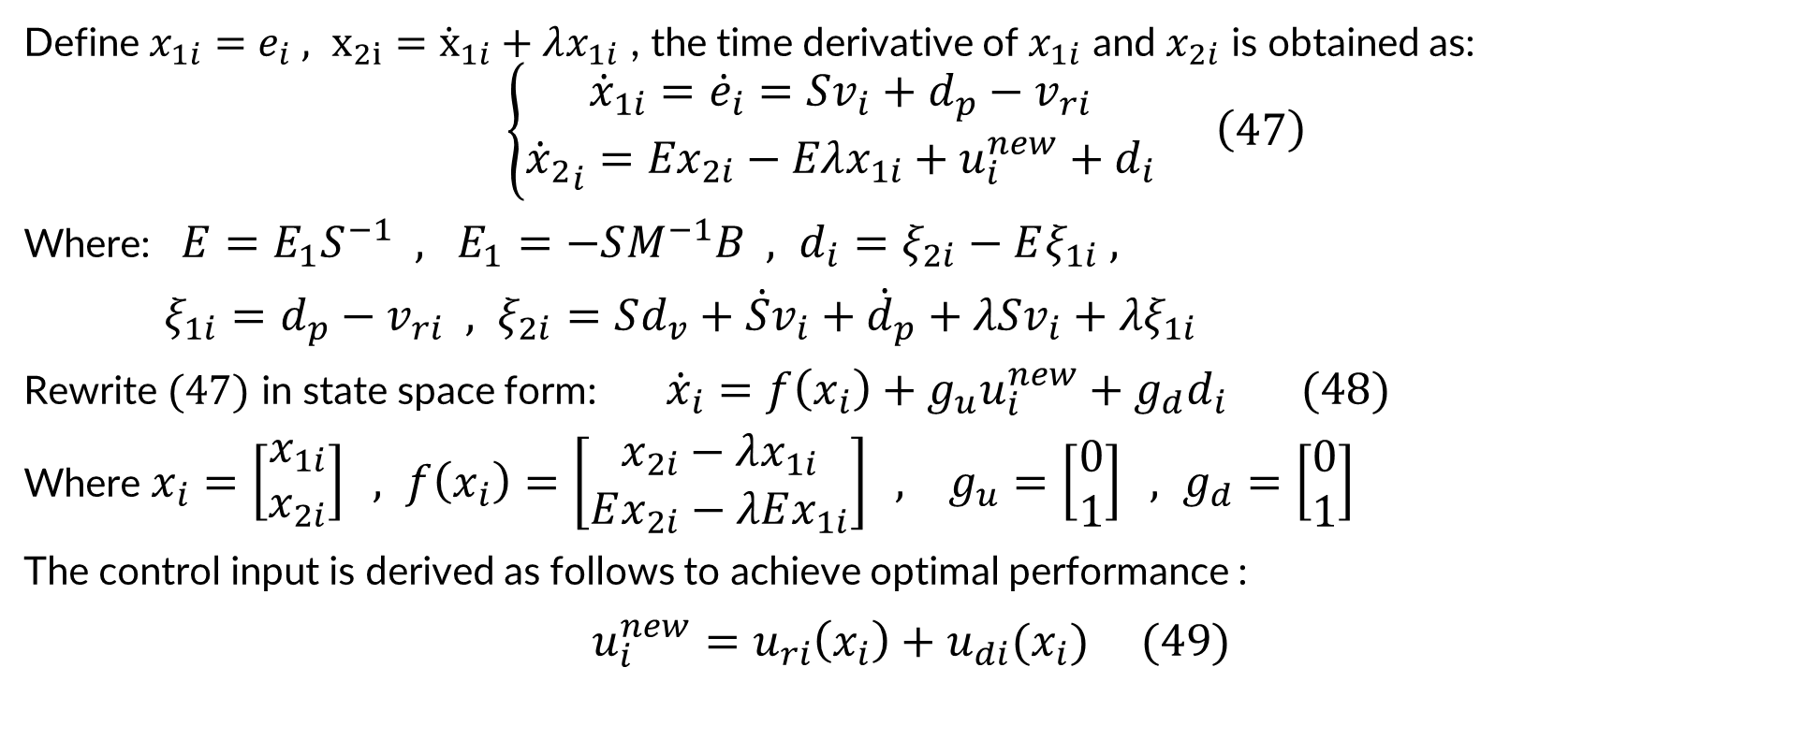
4. Multi-agent control using ADP approach
C. Tracking control design:
1. Control strategy
Define $x_{1i}=e_{i} , x_{2i}={\dot{x}}_{1i}+λx_{1i}$ , the time derivative of $x_{1i}$ and $x_{2i}$ is obtained as:
$$\left\{\begin{aligned}{\dot{x}}_{1i}={\dot{e}}_{i}=Sv_{i}+d_{p}−v_{ri} \\ {{\dot{x}}_{2}}_{i}={Ex}_{2i}−Eλx_{1i}+u_{i}^{new}+d_{i}\end{aligned}\right. \left(47\right)$$
Where: $E=E_{1}S^{−1} , E_{1}=−SM^{−1}B , d_{i}=ξ_{2i}−Eξ_{1i} ,$
$ξ_{1i}=d_{p}−v_{ri} , ξ_{2i}=Sd_{v}+\dot{S}v_{i}+{\dot{d}}_{p}+λSv_{i}+λξ_{1i}$
Rewrite $(47)$ in state space form: ${\dot{x}}_{i}=f\left(x_{i}\right)+g_{u}u_{i}^{new}+g_{d}d_{i} (48)$
Where $x_{i}=\left[\begin{matrix}x_{1i} \\ x_{2i}\end{matrix}\right] , f\left(x_{i}\right)=\left[\begin{matrix}x_{2i}−λx_{1i} \\ Ex_{2i}−λEx_{1i}\end{matrix}\right] , g_{u}=\left[\begin{matrix}0 \\ 1\end{matrix}\right] , g_{d}=\left[\begin{matrix}0 \\ 1\end{matrix}\right]$
The control input is derived as follows to achieve optimal performance :
$$u_{i}^{new}=u_{ri}\left(x_{i}\right)+u_{di}(x_{i}) (49)$$

Slide 35
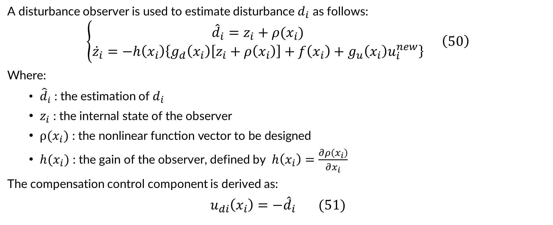
4. Multi-agent control using ADP approach
C. Tracking control design:
2. Observer-based controller design
A disturbance observer is used to estimate disturbance $d_{i}$ as follows:
$$\left\{\begin{aligned}{\hat{d}}_{i}=z_{i}+ρ(x_{i}) \\ {\dot{z}}_{i}=−h\left(x_{i}\right)\left\{g_{d}\left(x_{i}\right)\left[z_{i}+ρ\left(x_{i}\right)\right]+f\left(x_{i}\right)+g_{u}\left(x_{i}\right)u_{i}^{new}\right\}\end{aligned}\right. \left(50\right)$$
Where:
${\hat{d}}_{i}$ : the estimation of $d_{i}$
$z_{i}$ : the internal state of the observer
$ρ(x_{i})\text{ : }\text{the} \text{nonlinear} \text{function} \text{vector} \text{to} \text{be} \text{designed}$
${h(x}_{i})$ : the gain of the observer, defined by $h\left(x_{i}\right)=\frac{∂ρ\left(x_{i}\right)}{∂x_{i}}$
The compensation control component is derived as:
$$u_{di}\left(x_{i}\right)=−{\hat{d}}_{i} (51)$$

Slide 36
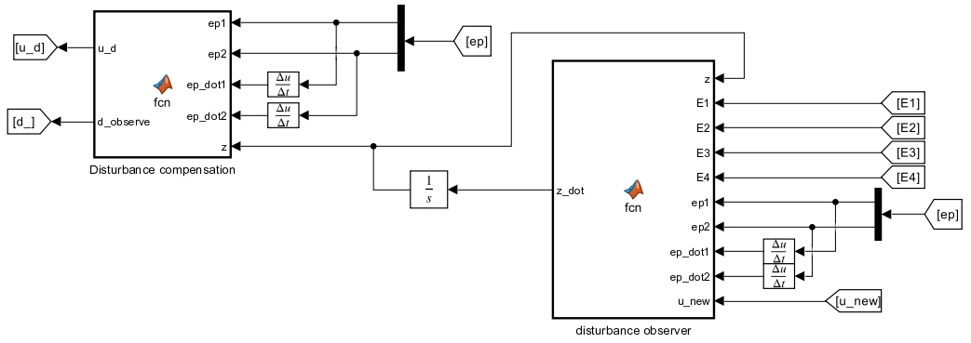
4. Multi-agent control using ADP approach
C. Tracking control design:
2. Observer-based controller design
The observer-based controller simulation implementation:

Slide 37
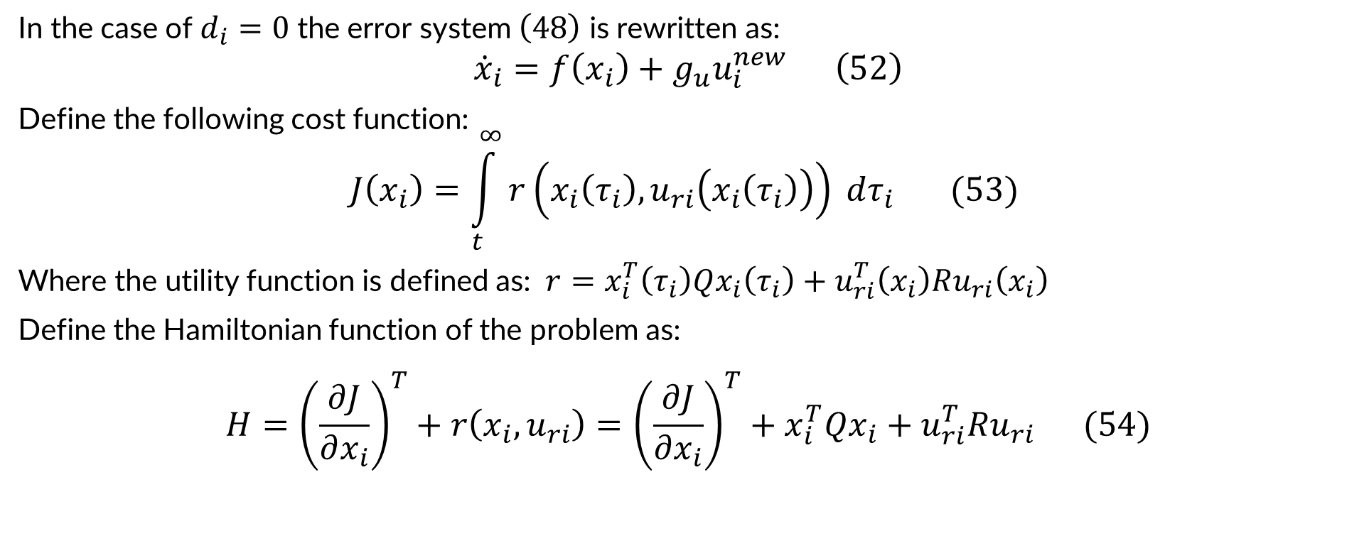
4. Multi-agent control using ADP approach
C. Tracking control design:
3. Adaptive optimal controller design
In the case of $d_{i}=0$ the error system $\left(48\right)$ is rewritten as:
$${\dot{x}}_{i}=f\left(x_{i}\right)+g_{u}u_{i}^{new} \left(52\right)$$
Define the following cost function:
$$J\left(x_{i}\right)=\int_{t}^{∞}{r\left(x_{i}\left(τ_{i}\right),u_{ri}\left(x_{i}\left(τ_{i}\right)\right)\right) dτ_{i} (53) }$$
Where the utility function is defined as: $r=x_{i}^{T}\left(τ_{i}\right)Qx_{i}\left(τ_{i}\right)+u_{ri}^{T}\left(x_{i}\right)Ru_{ri}\left(x_{i}\right)$
Define the Hamiltonian function of the problem as:
$$H={\left(\frac{∂J}{∂x_{i}}\right)}^{T}+r\left(x_{i},u_{ri}\right)={\left(\frac{∂J}{∂x_{i}}\right)}^{T}+x_{i}^{T}Qx_{i}+u_{ri}^{T}Ru_{ri} (54)$$

Slide 38
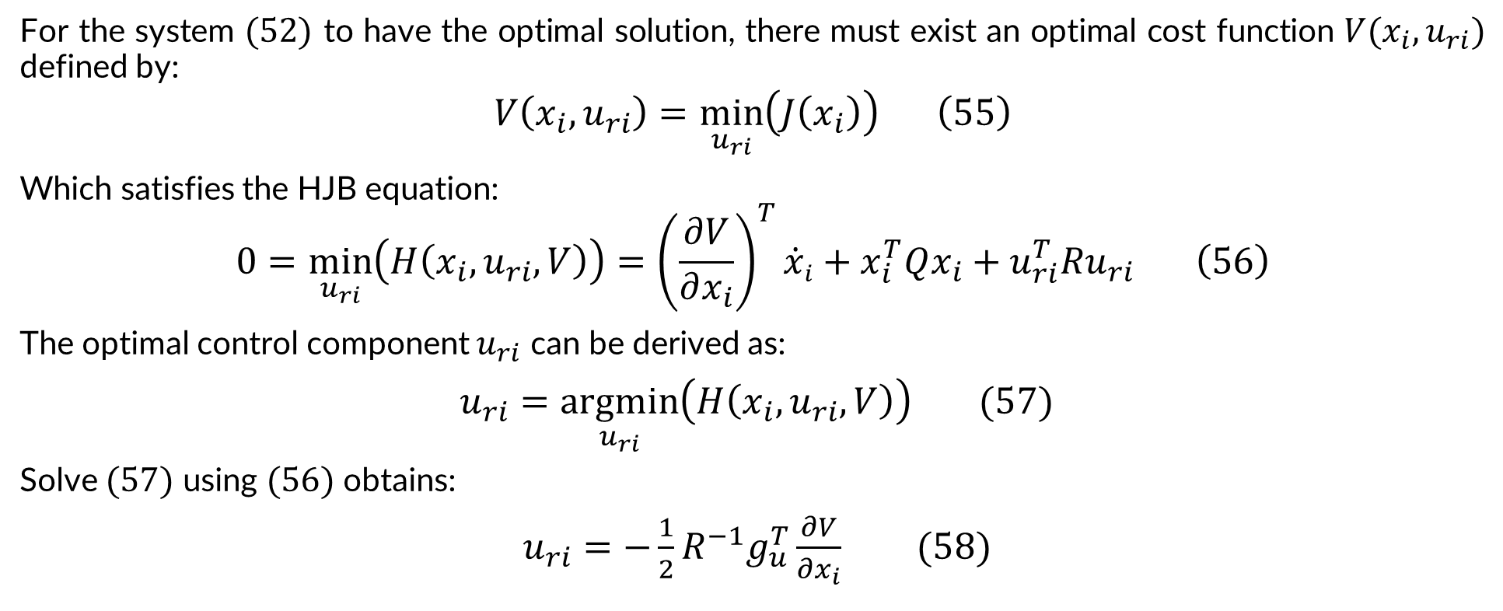
4. Multi-agent control using ADP approach
C. Tracking control design:
3. Adaptive optimal controller design
For the system $(52)$ to have the optimal solution, there must exist an optimal cost function $V(x_{i},u_{ri})$ defined by:
$$V\left(x_{i},u_{ri}\right)=\min_{u_{ri}}\left(J\left(x_{i}\right)\right) \left(55\right)$$
Which satisfies the HJB equation:
$$0=\min_{u_{ri}}\left(H\left(x_{i},u_{ri},V\right)\right)={\left(\frac{∂V}{∂x_{i}}\right)}^{T}{\dot{x}}_{i}+x_{i}^{T}Qx_{i}+u_{ri}^{T}Ru_{ri} \left(56\right)$$
The optimal control component $u_{ri}$ can be derived as:
$u_{ri}=\underset{u_{ri}}{argmin}\left(H\left(x_{i},u_{ri},V\right)\right) (57)$
Solve $(57)$ using $(56)$ obtains:
$u_{ri}=−\frac{1}{2}R^{−1}g_{u}^{T}\frac{∂V}{∂x_{i}} (58)$

Slide 39
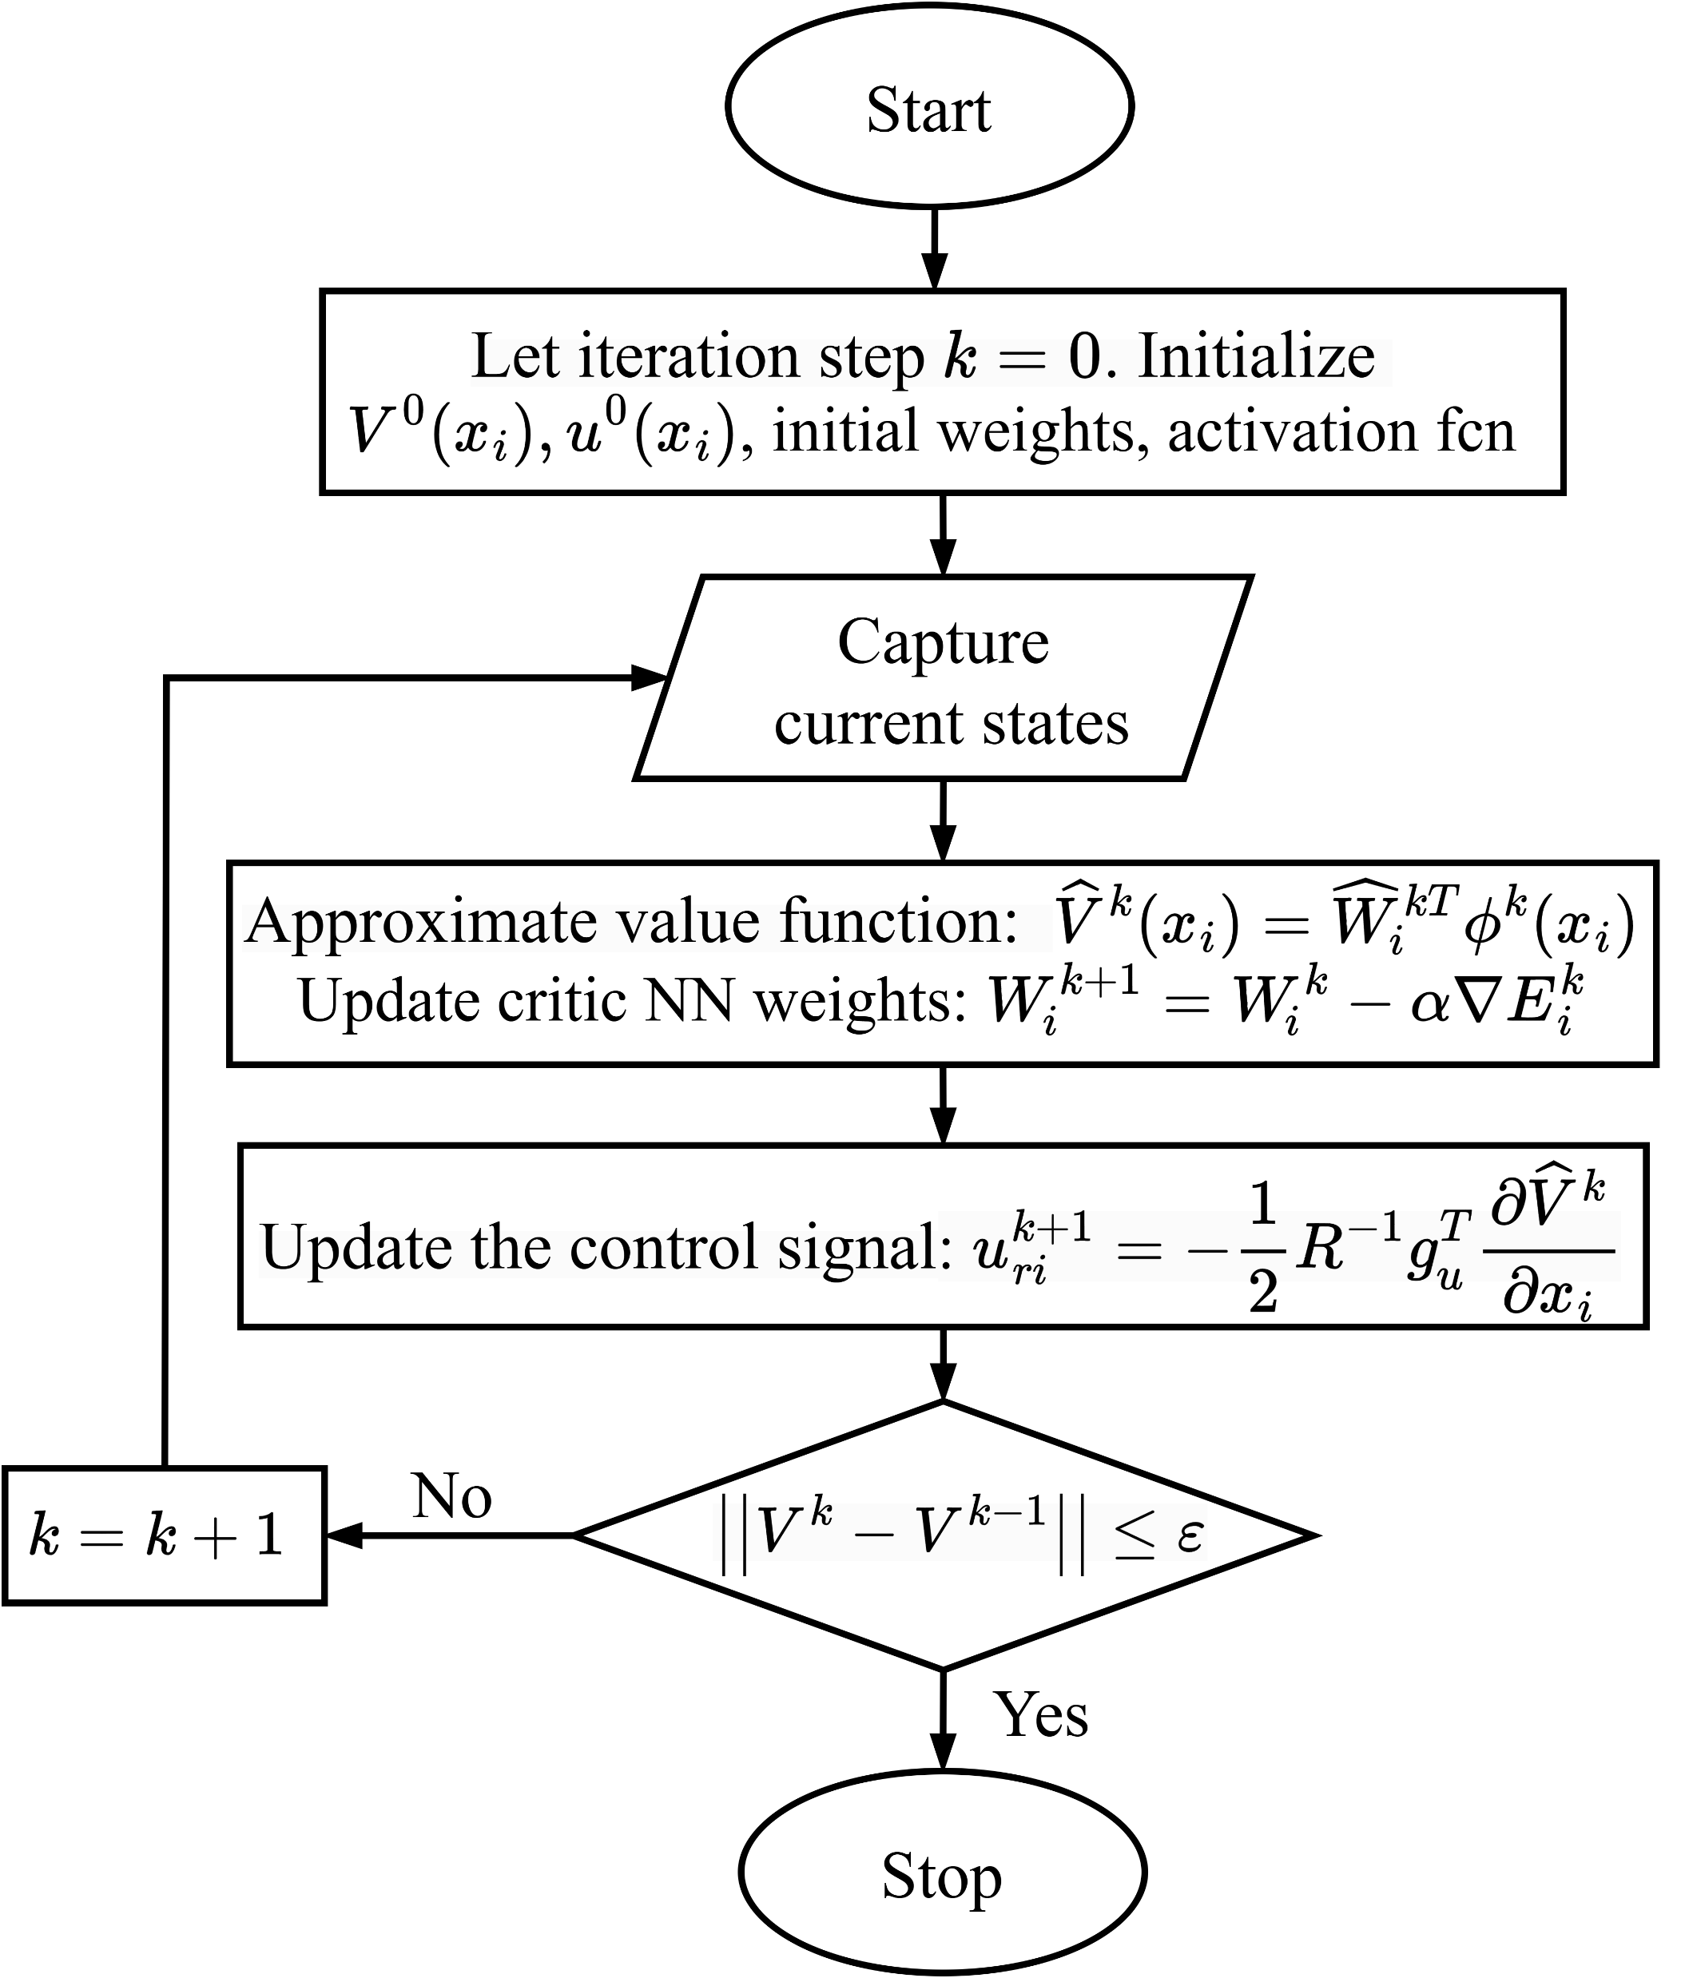
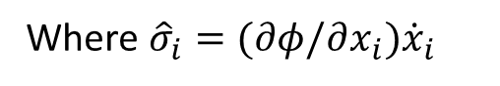
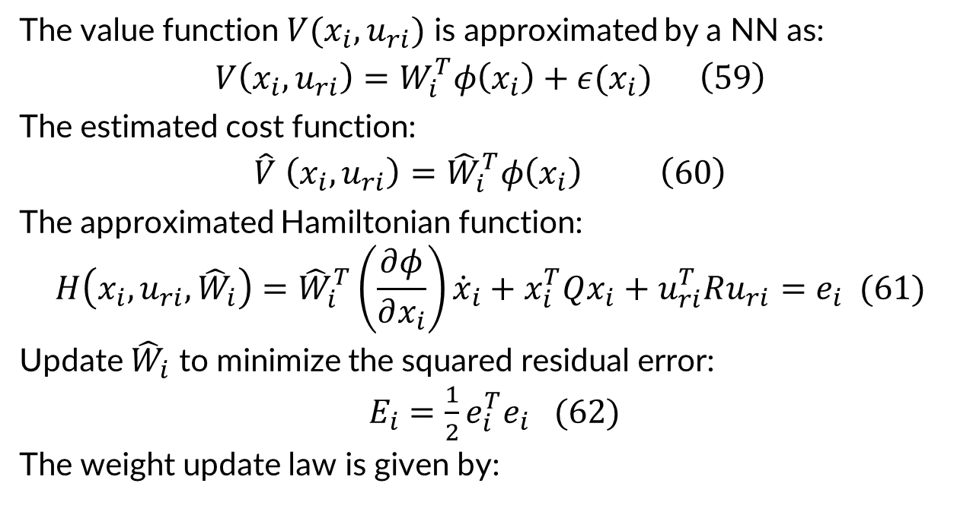
4. Multi-agent control using ADP approach
C. Tracking control design:
3. Adaptive optimal controller design
The value function $V(x_{i},u_{ri})$ is approximated by a NN as:
$$V\left(x_{i},u_{ri}\right)=W_{i}^{T}φ\left(x_{i}\right)+ε(x_{i}) \left(59\right)$$
The estimated cost function:
$$\hat{V} \left(x_{i},u_{ri}\right)={\hat{W}}_{i}^{T}φ\left(x_{i}\right) \left(60\right)$$
The approximated Hamiltonian function:
$$H\left(x_{i},u_{ri},{\hat{W}}_{i}\right){={\hat{W}}_{i}^{T}\left(\frac{∂φ}{∂x_{i}}\right){\dot{x}}_{i}}+x_{i}^{T}Qx_{i}+u_{ri}^{T}Ru_{ri}=e_{i} (61)$$
Update ${\hat{W}}_{i}$ to minimize the squared residual error:
$E_{i}=\frac{1}{2}e_{i}^{T}e_{i} (62)$
The weight update law is given by:
$${\hat{W}}_{i}=−α_{1}\frac{{\hat{σ}}_{i}}{{\left({\hat{σ}}_{i}^{T}{\hat{σ}}_{i}+1\right)}^{2}}\left({\hat{σ}}_{i}^{T}{\hat{W}}_{i}+Q\left(x_{i}\right)+u_{ri}^{T}Ru_{ri}\right)+\frac{1}{2}α_{2}\frac{∂φ}{∂x_{i}}g_{u}R^{−1}g_{u}^{T}x_{i} (63)$$
On-policy ADP algorithm
Where ${\hat{σ}}_{i}=(∂φ/∂x_{i}){\dot{x}}_{i}$

Slide 40
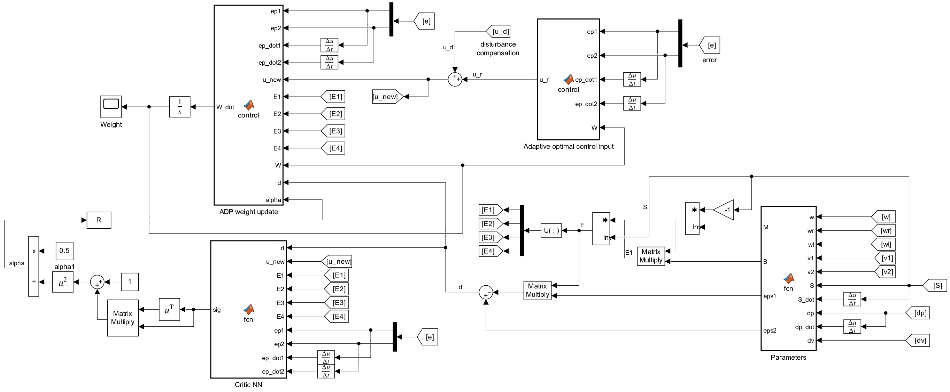
4. Multi-agent control using ADP approach
The adaptive optimal control simulation implementation:

Slide 41
Simulation and Results

Slide 42
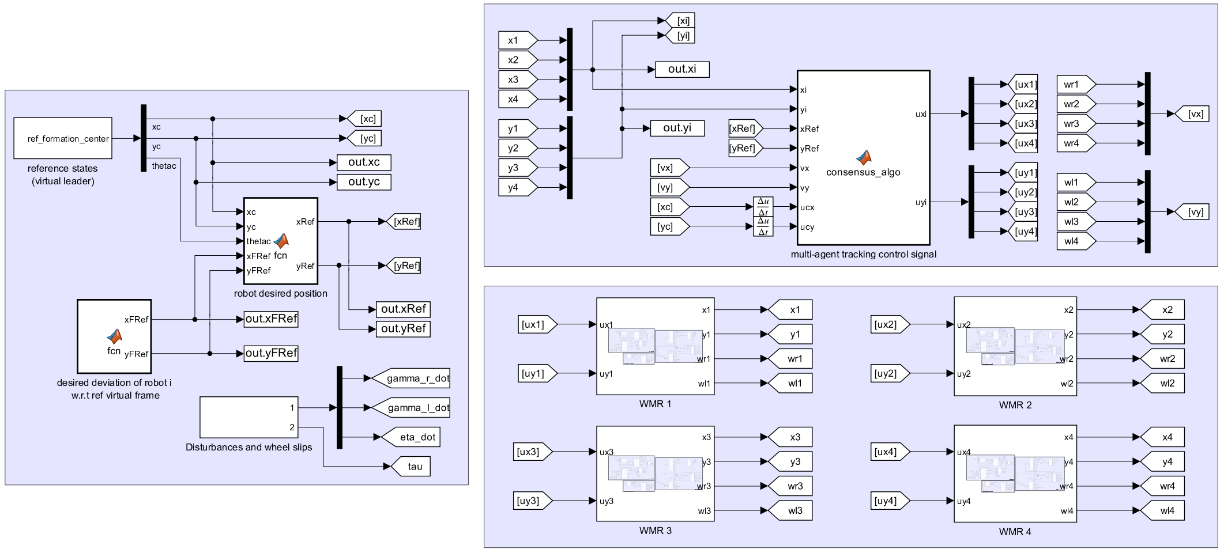
5. Simulation implementation
Overall system simulation :
Multi-agent control
Parameters generation
WMR system

Slide 43





5. Simulation results
A. Formation tracking results of multiple WMRs
- Scenario $1$: Triangle formation
Circle trajectory: $\left\{\begin{aligned}x_{c}=3\sin\left(\frac{π}{6}t\right) \\ y_{c}=3\cos\left(\frac{π}{6}t\right)\end{aligned}\right.$
Line trajectory: $\left\{\begin{aligned}x_{c}=3+0.75t \\ y_{c}=−2+0.5t\end{aligned}\right.$

Slide 44



5. Simulation results
A. Formation tracking results of multiple WMRs
- Scenario $2$: Square formation
Line trajectory
Circle trajectory

Slide 45


5. Simulation results
A. Formation tracking results of multiple WMRs
Results of ADP-based optimal control for agent 1 tracking triangle formation while following line trajectory

Slide 46



5. Simulation results
B. Comparison between ADP-based optimal control method and conventional feedback linearization control method:
Curved trajectory: $\left\{\begin{aligned}x_{c}=−t \\ y_{c}=\sin\left(0.5t\right)+0.5t+1\end{aligned}\right.$
In case of no disturbance:

Slide 47


5. Simulation results
B. Comparison between ADP-based optimal control method and conventional feedback linearization control method:
In case of wheel slip and external disturbance:

Slide 48
6. Conclusion
In general, the WMR system achieves the desired formations while following the predefined trajectories.
The approach assumes each agent has consistent understanding of the formation center. Future study can focus on designing consensus algorithm to drive each agent’s instantiation of the virtual center to a common value.
The proposed method requires knowledge of the system’s internal dynamics. Future improvement may focus on developing model-free control algorithms that rely solely on system state data.
Possibly develop more effective multi-agent control algorithms. These advancements may include distance-based control, direction vector-based control, and graph rigidity theory-based methods.

Slide 49
Reference
[1] N. Van Tinh et al., “Neural network-based adaptive tracking control for a nonholonomic wheeled mobile robot subject to unknown wheel slips,” Journal of Computer Science and Cybernetics, vol. 33, no. 1, pp. 70–85, 2017.
[2] N. M. H. Trịnh Hoàng Minh, “Điều khiển hệ đa tác tử,” 2021.
[3] W. Ren and R. W. Beard, Distributed consensus in multi-vehicle cooperative control, vol. 27. Springer, 2008.
[4] W.-H. Chen, “Disturbance observer based control for nonlinear systems,” IEEE/ASME transactions on mechatronics, vol. 9, no. 4, pp. 706–710, 2004.
[5] H. Van Doan and N. T.-T. Vu, “Robust optimal control for uncertain wheeled mobile robot based on reinforcement learning: Adp approach,” Bulletin of Electrical Engineering and Informatics, vol. 13, no. 3, pp. 1524–1534, 2024.
[6] R. Song and F. L. Lewis, “Robust optimal control for a class of nonlinear systems with unknown disturbances based on disturbance observer and policy iteration,” Neurocomputing, vol. 390, pp. 185–195, 2020

Slide 50
THANK YOU !

